Slide 1
Doughnut Economics
turning ideas into action
An introduction to core concepts
Kate Raworth
July 2023

Slide 2
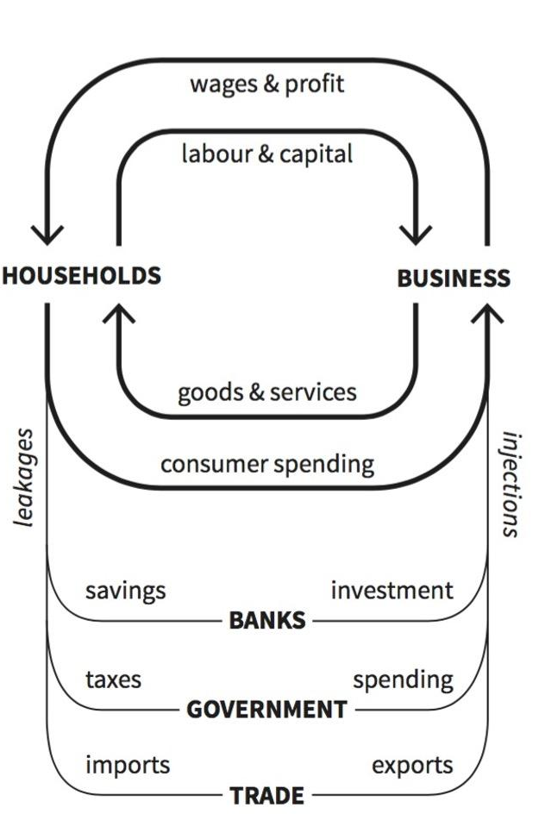
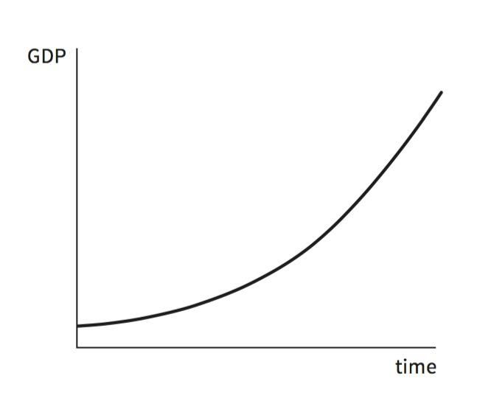
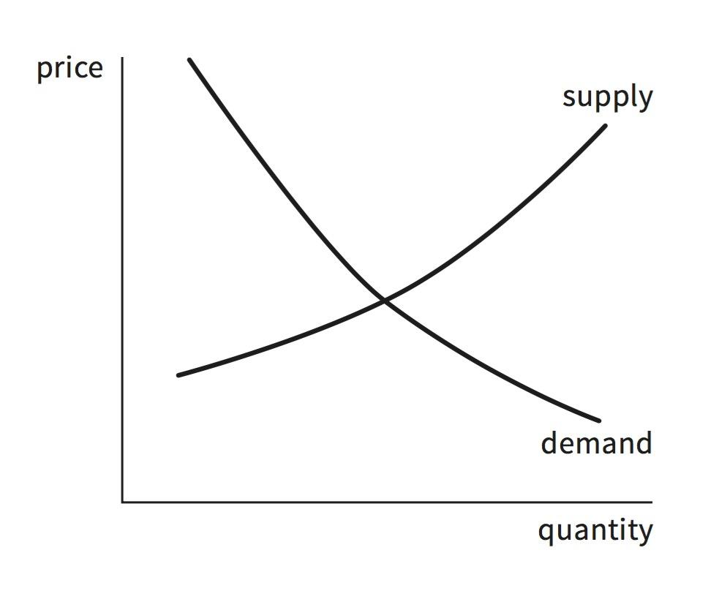
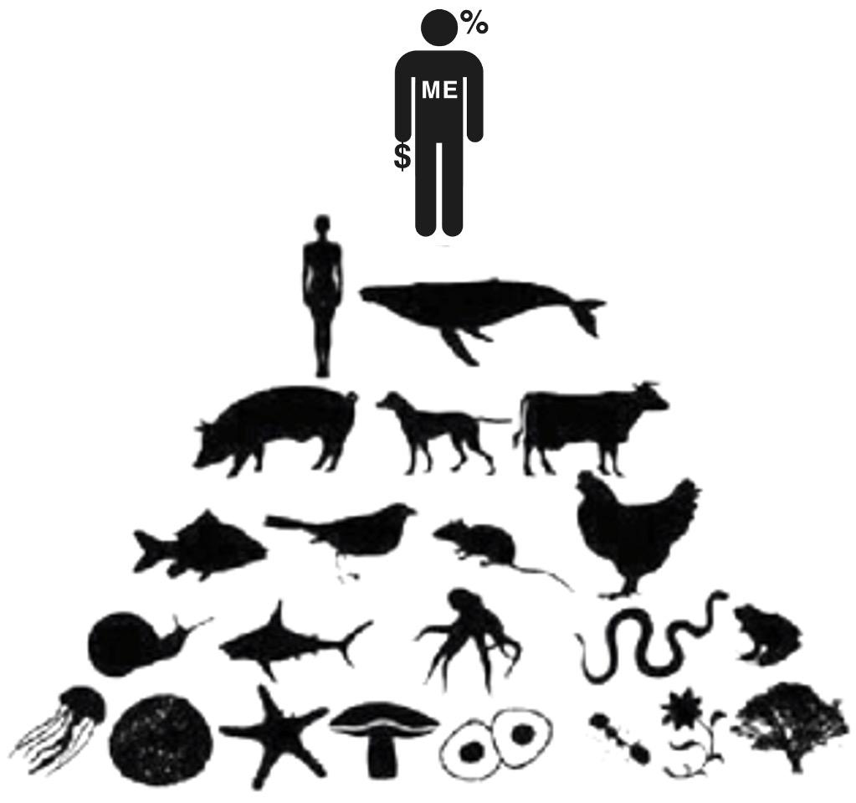
20th century economics
The first
image
The big
picture
The self
portrait
The
goal
‹#›

Slide 3
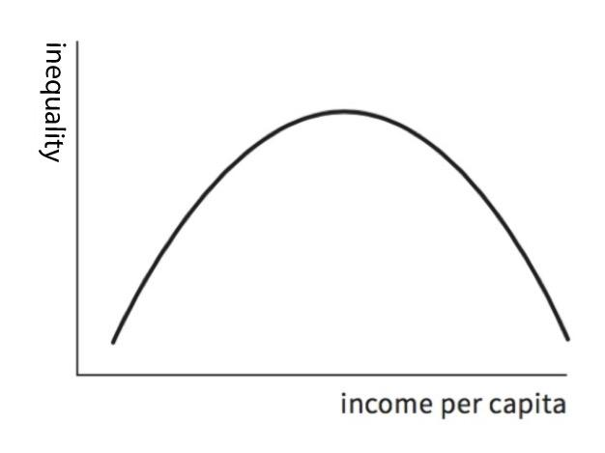
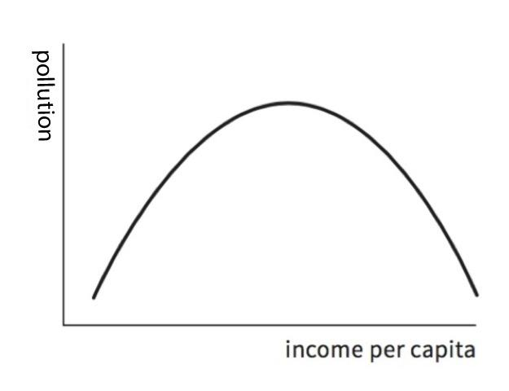
20th century economics
Inequality
Environment
‘The Kuznets Curve’
‘The Environmental Kuznets Curve’
‘Growth will
even things up again’
‘Growth will
clean things up again’

Slide 4
How the 21st century began
Financial meltdown
Climate breakdown
Protest crackdown
COVID lockdown
‹#›

Slide 5
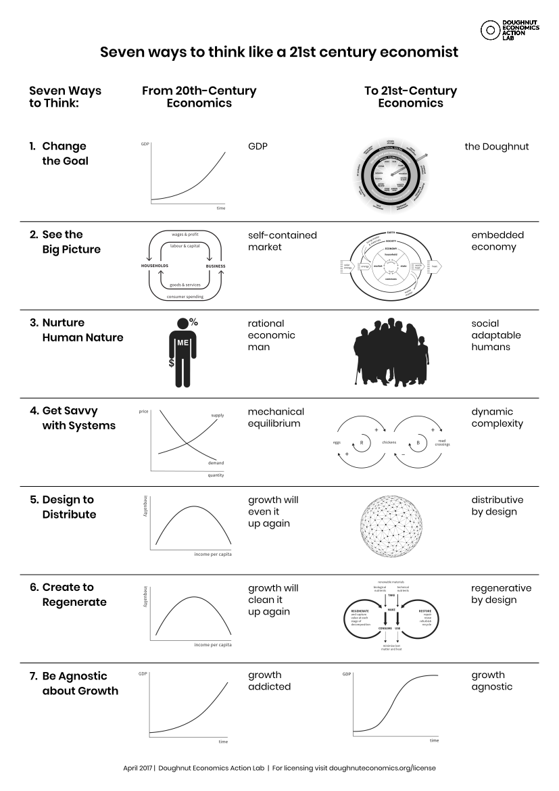

Slide 6
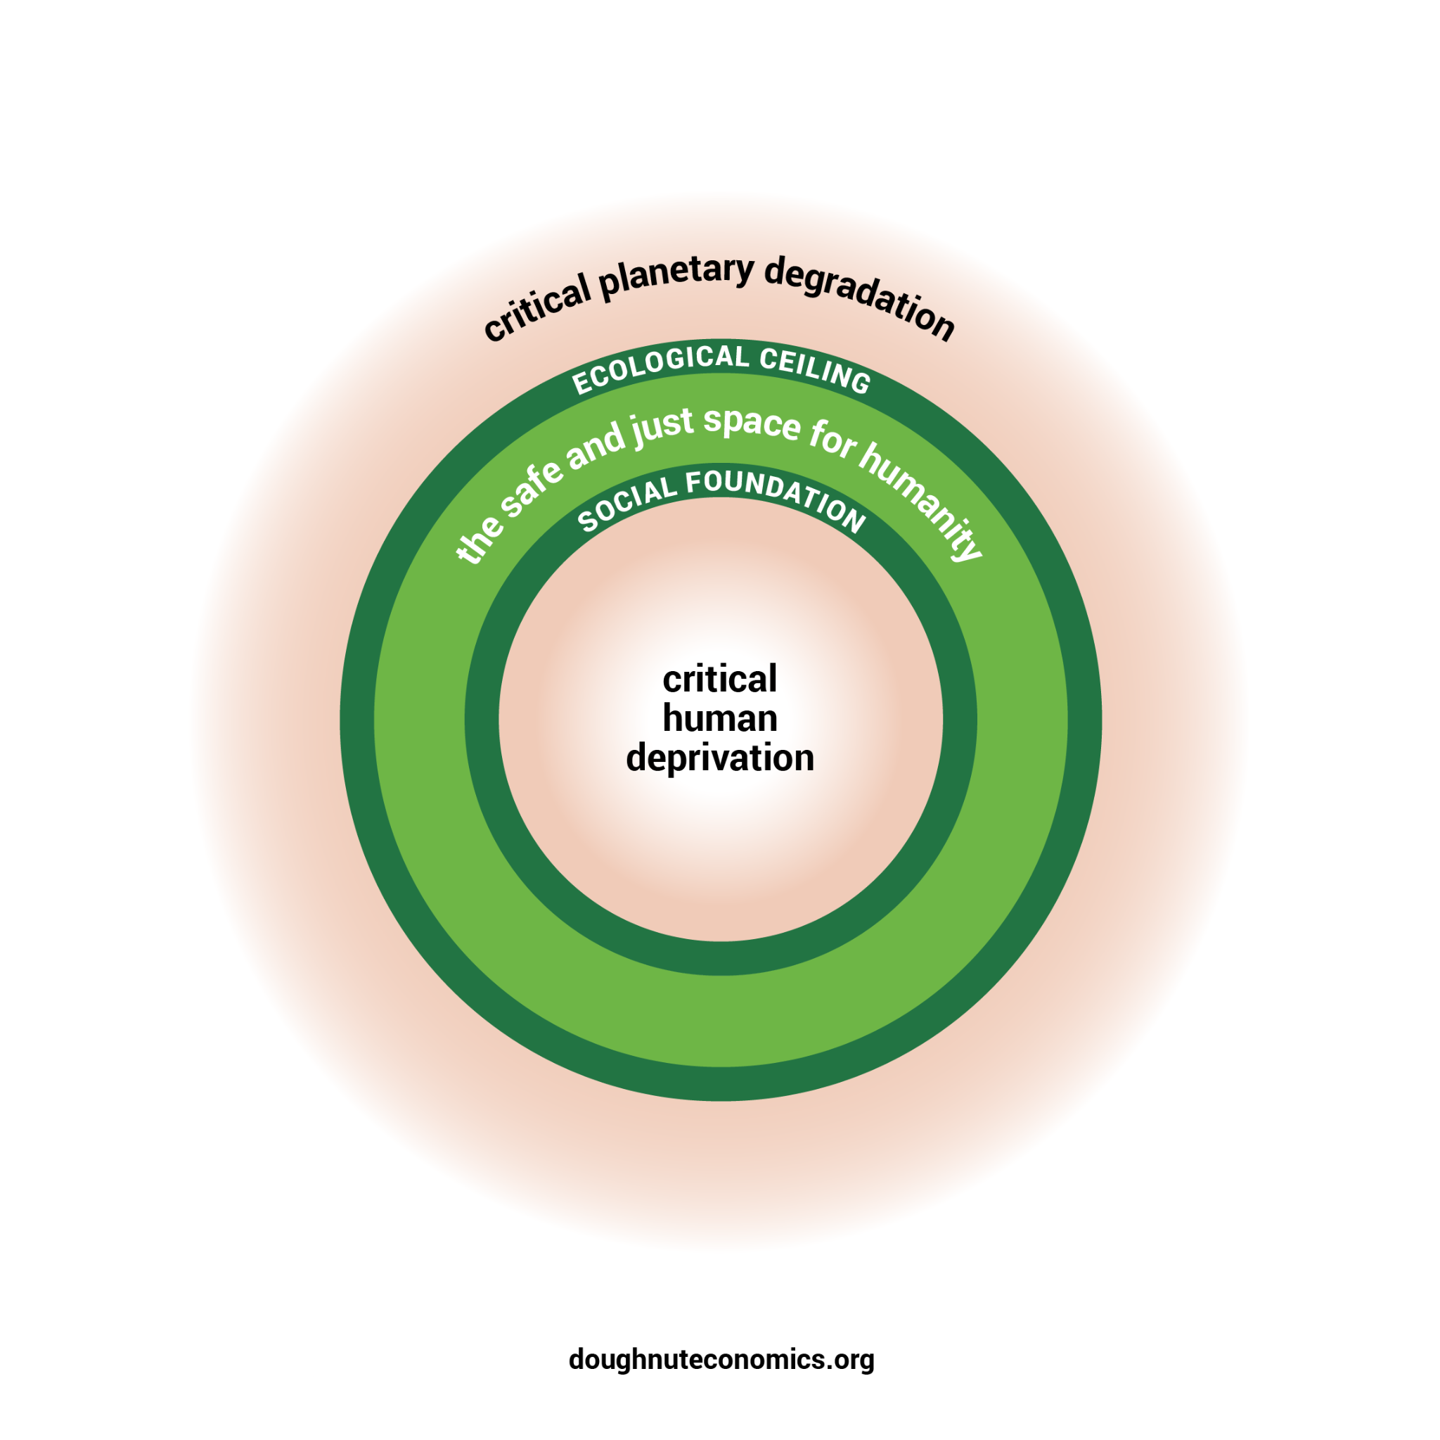
A compass for human prosperity
Raworth 2017
‹#›
Notes:
Compass and map.
Also simple – focuses not on monetary flows but on nature’s flows, and on fundamental relationships of humanity to the rest of the living world.
Map just as important as doughnut – spend this session getting to know its parts, invite you to add and evolve this diagram…

Slide 7
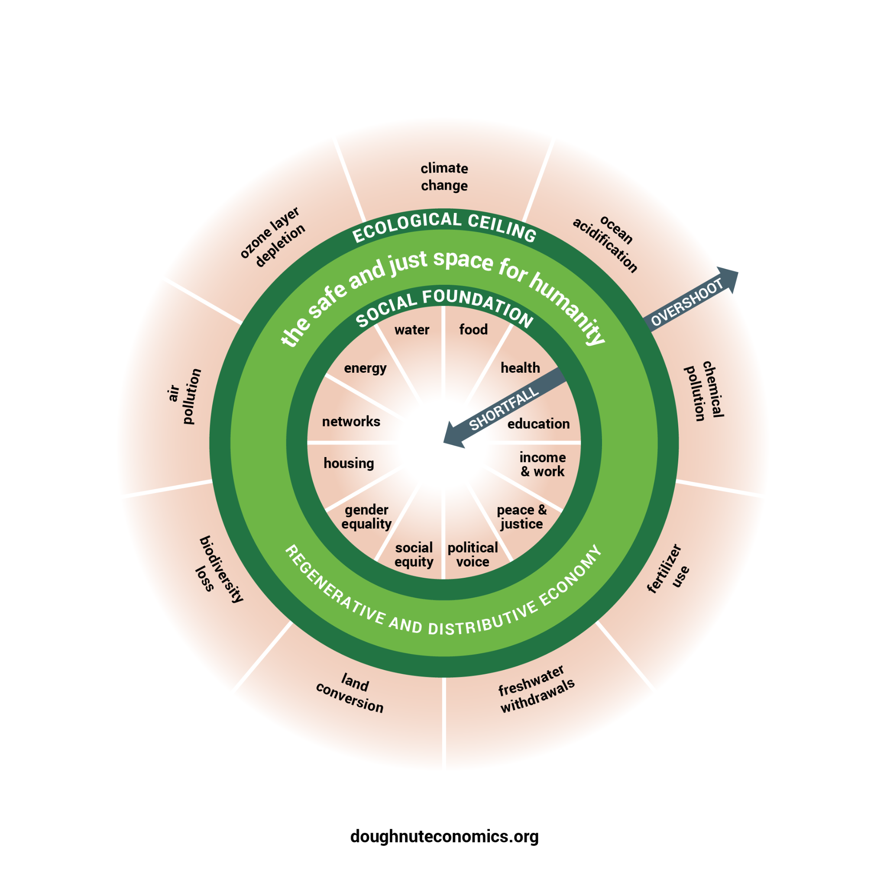
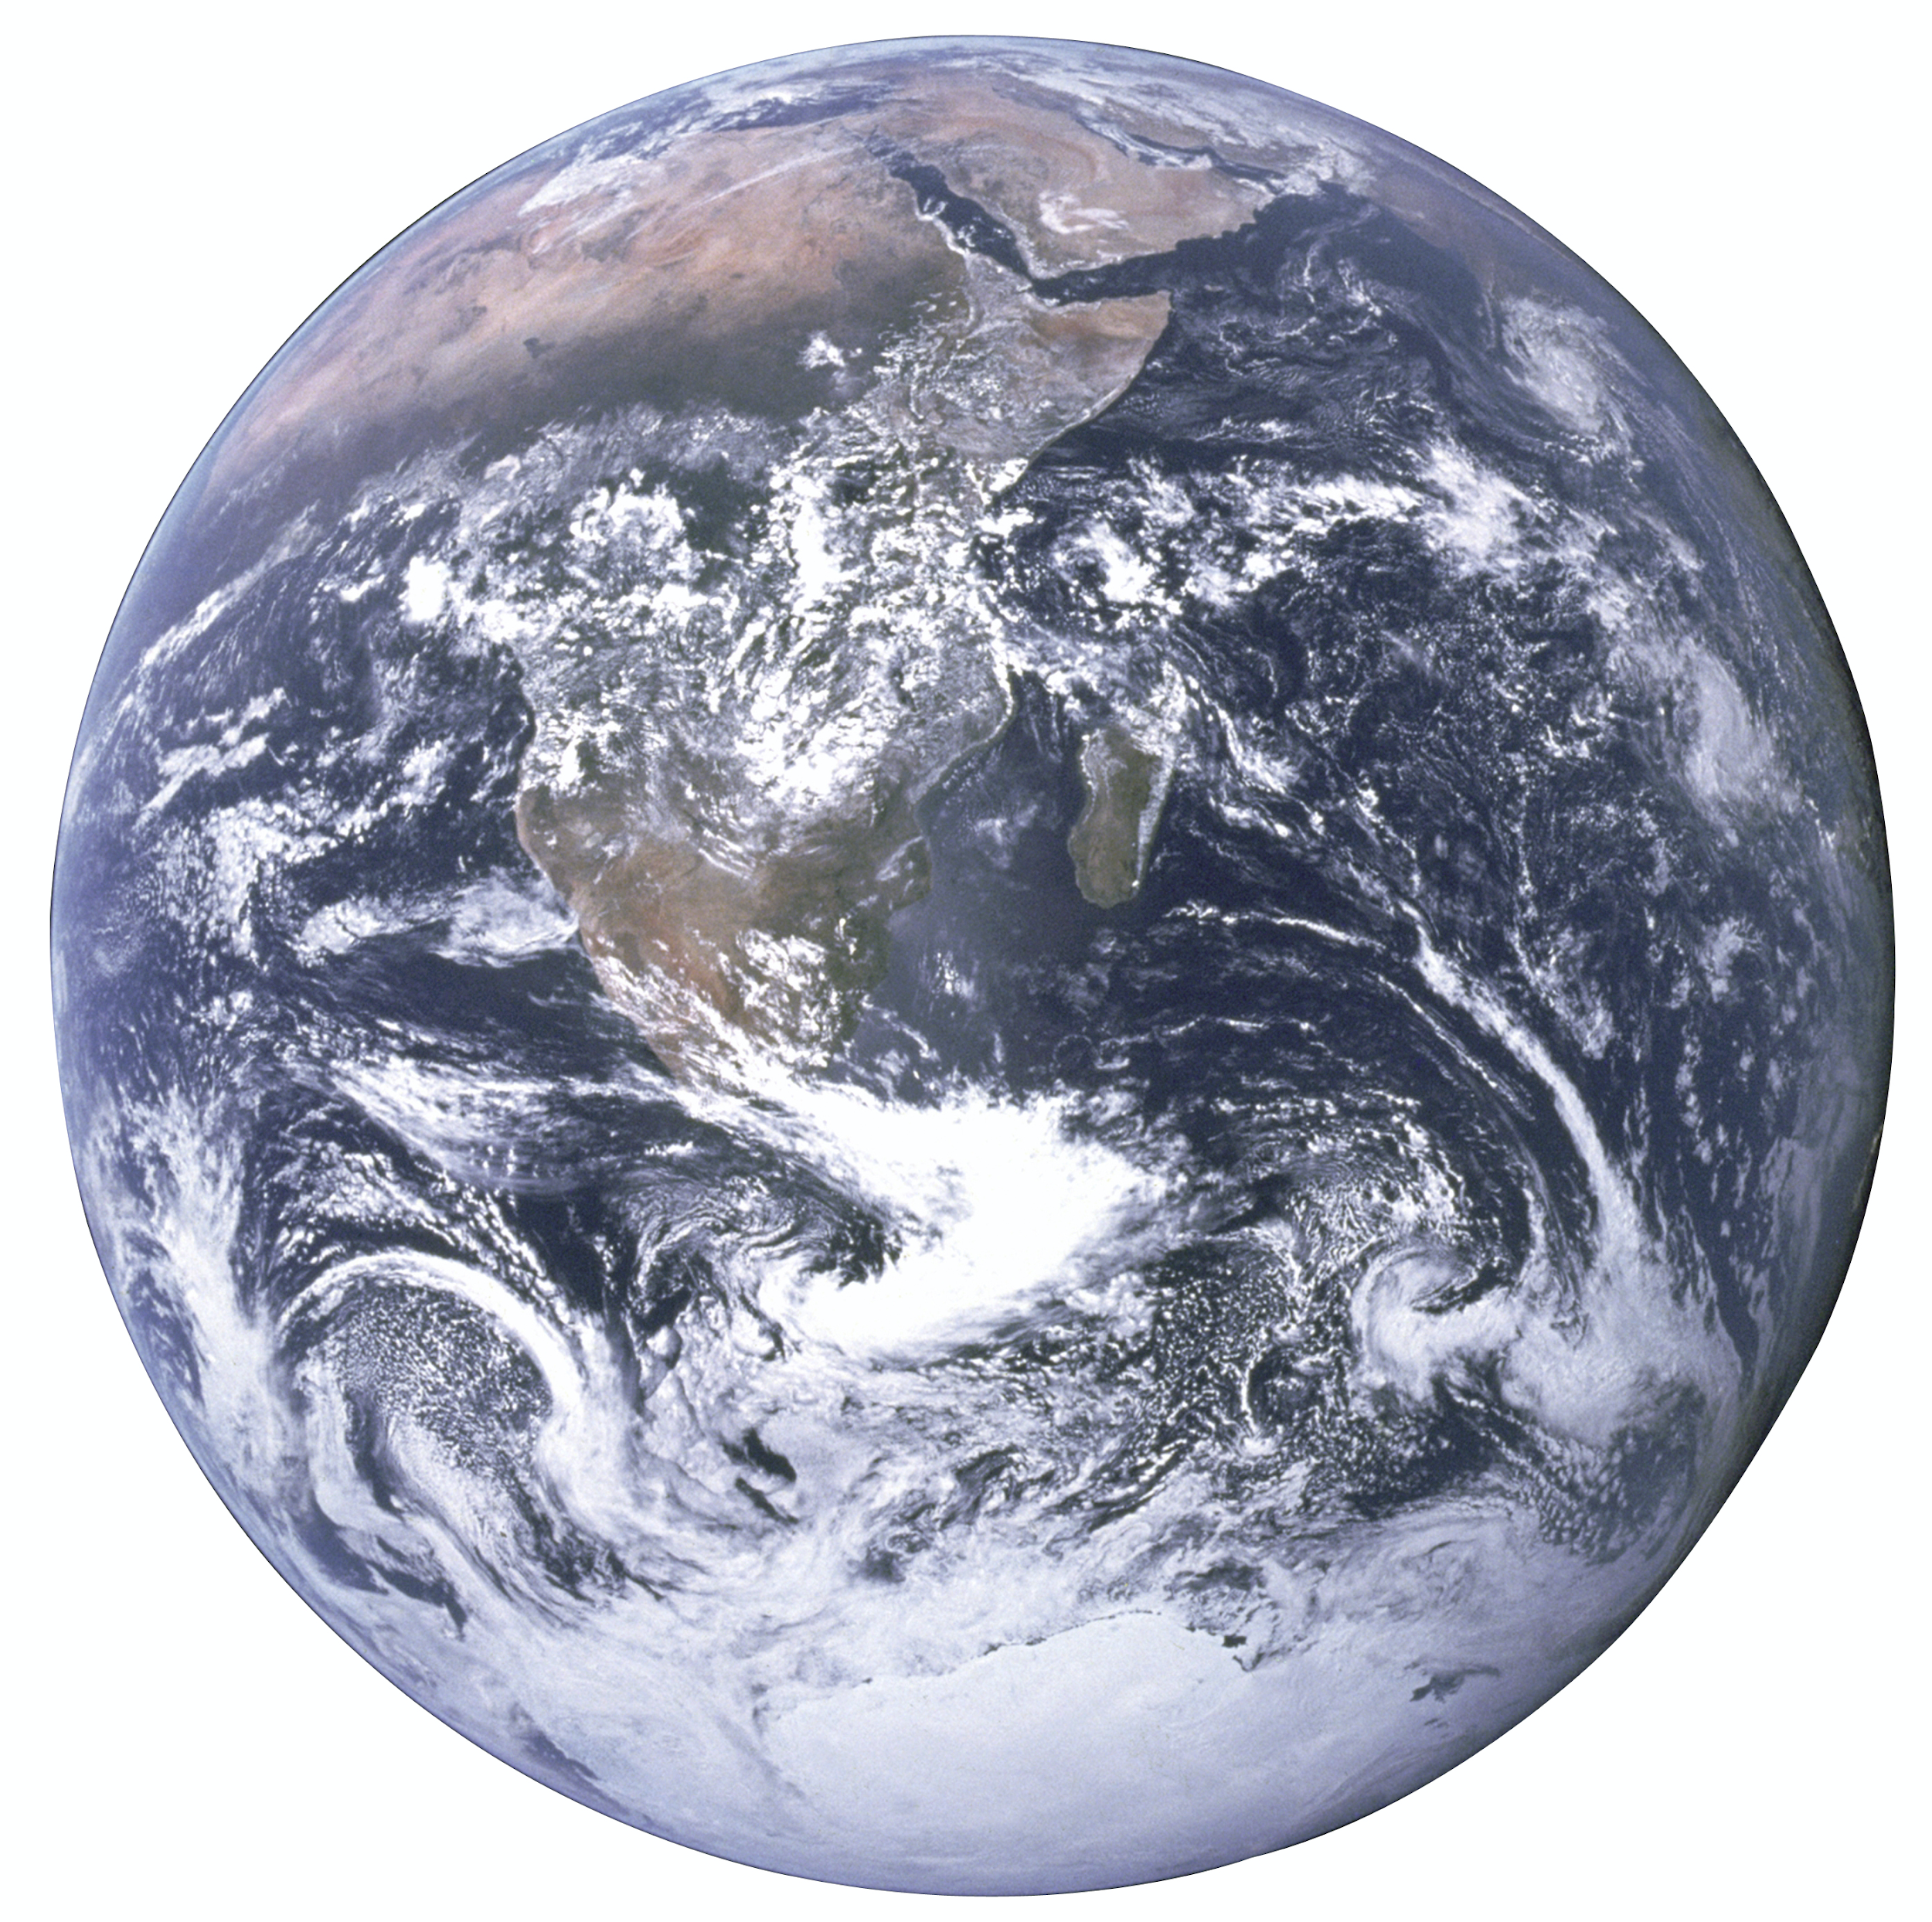
A compass for human prosperity
A compass for human prosperity
PLANETARY
BOUNDARIES
UN 2015, Steffen et al 2015
Raworth 2017
‹#›
Notes:
Compass and map.
Also simple – focuses not on monetary flows but on nature’s flows, and on fundamental relationships of humanity to the rest of the living world.
Map just as important as doughnut – spend this session getting to know its parts, invite you to add and evolve this diagram…

Slide 8
A compass for human prosperity
A compass for human prosperity
Raworth 2017
‹#›
Notes:
Compass and map.
Also simple – focuses not on monetary flows but on nature’s flows, and on fundamental relationships of humanity to the rest of the living world.
Map just as important as doughnut – spend this session getting to know its parts, invite you to add and evolve this diagram…

Slide 9
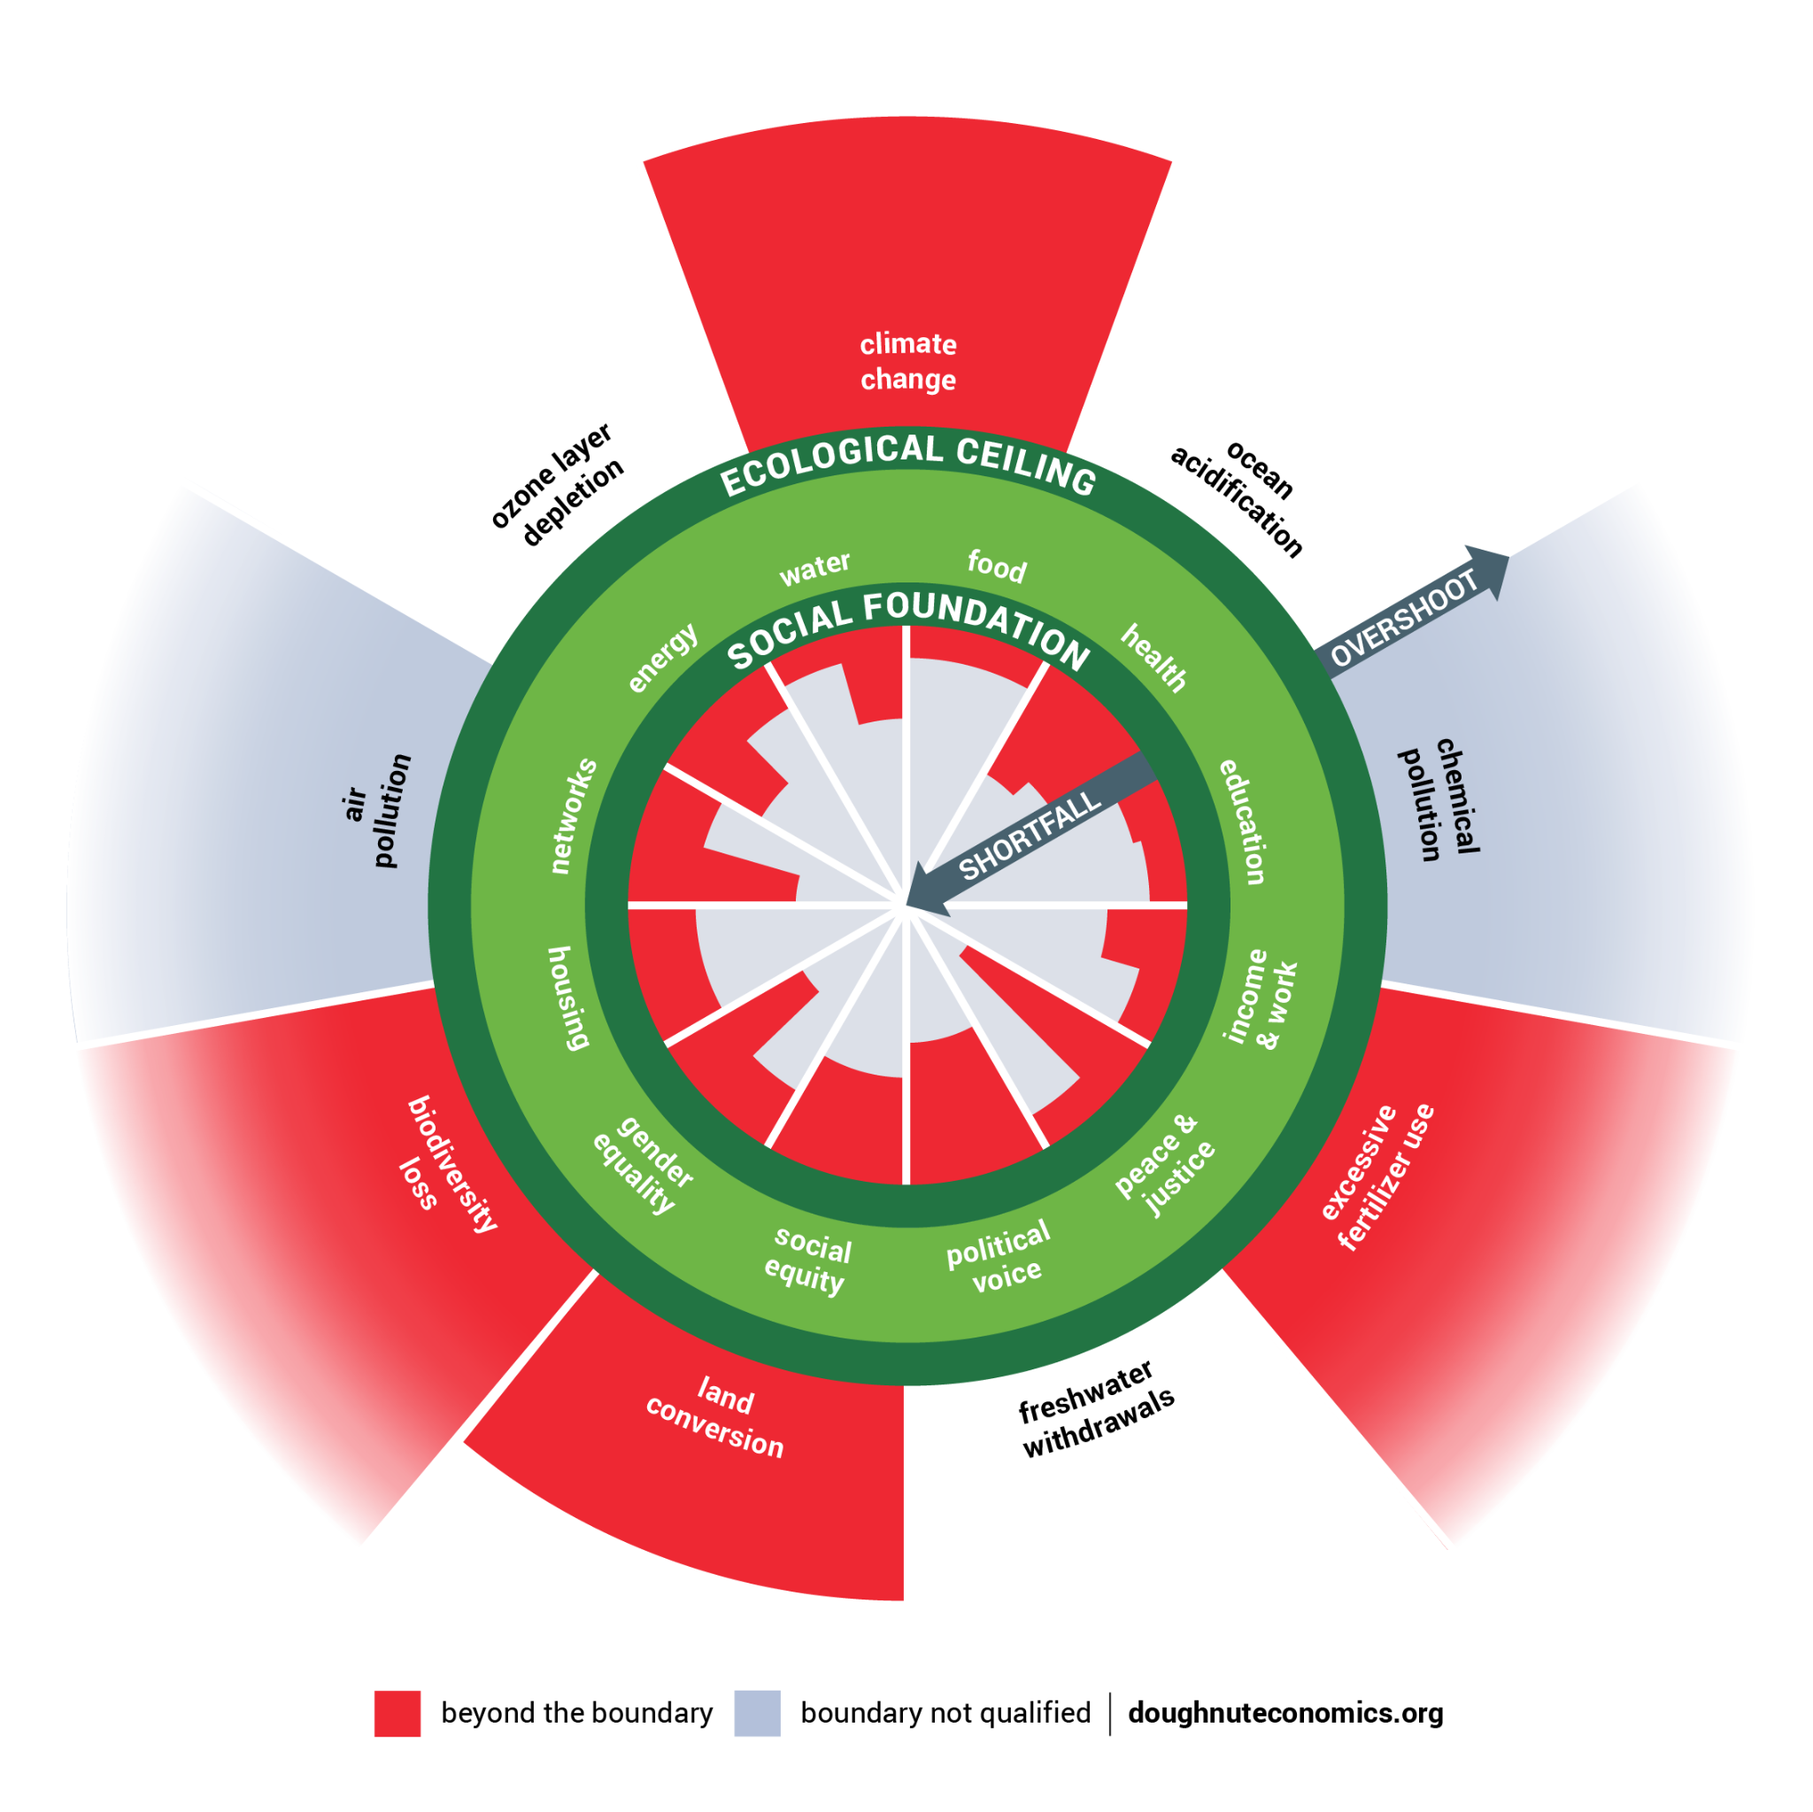
A world dangerously out of balance
Beyond the boundary
Boundary not quantified
Raworth 2017, Steffen et al (2015)
‹#›
Notes:
Compass and map.
Also simple – focuses not on monetary flows but on nature’s flows, and on fundamental relationships of humanity to the rest of the living world.
Map just as important as doughnut – spend this session getting to know its parts, invite you to add and evolve this diagram…

Slide 10
A world dangerously out of balance
Raworth 2017
‹#›
Notes:
Compass and map.
Also simple – focuses not on monetary flows but on nature’s flows, and on fundamental relationships of humanity to the rest of the living world.
Map just as important as doughnut – spend this session getting to know its parts, invite you to add and evolve this diagram…

Slide 11
A world dangerously out of balance
Beyond the boundary
Boundary not quantified
Raworth 2017, Steffen et al (2015)
‹#›
Notes:
Compass and map.
Also simple – focuses not on monetary flows but on nature’s flows, and on fundamental relationships of humanity to the rest of the living world.
Map just as important as doughnut – spend this session getting to know its parts, invite you to add and evolve this diagram…

Slide 12
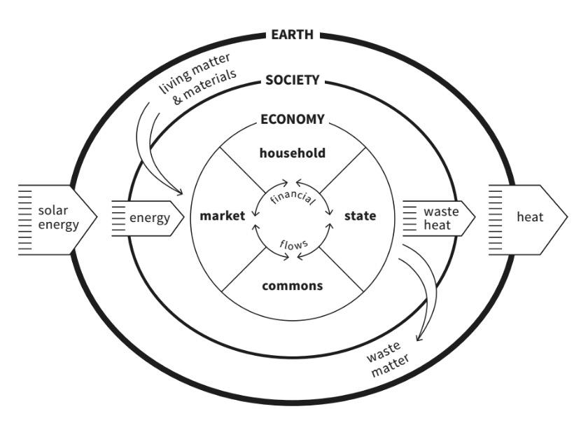
The Embedded Economy
stable
climate
thriving
biodiversity
political
social
ozone
protection
fertile
soils
healthy oceans
cultural
legal
nutrient
cycle
freshwater
cycle
Raworth 2017

Slide 13
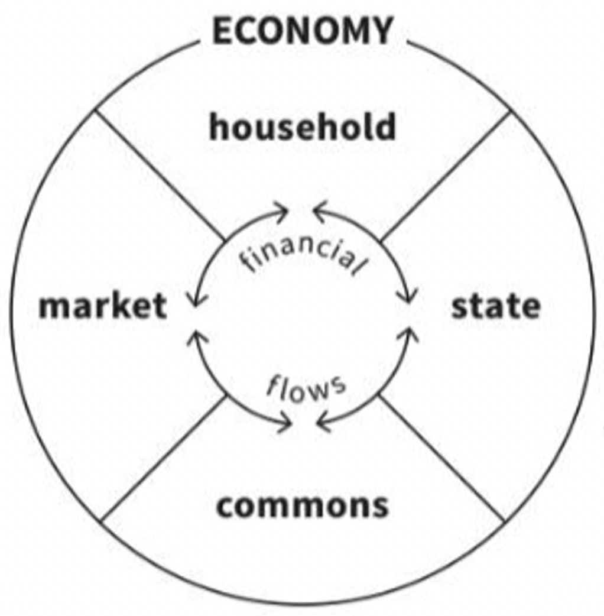
parent
child
partner
relative
kin-less
We have many economic roles and relations
consumer
producer
labourer
capital-owner
destitute
resident
public servant
voter
protester
stateless
creditor
debtor
investor
speculator
financially excluded
commoner
steward
co-creator
volunteer
excluded
Raworth 2017

Slide 14
Nurture Human Nature
Rational economic man
Social adaptable humans
self-interested | social reciprocity
fixed preferences | fluid values
isolated | interdependent
calculating | approximating
dominant | dependent

Slide 15
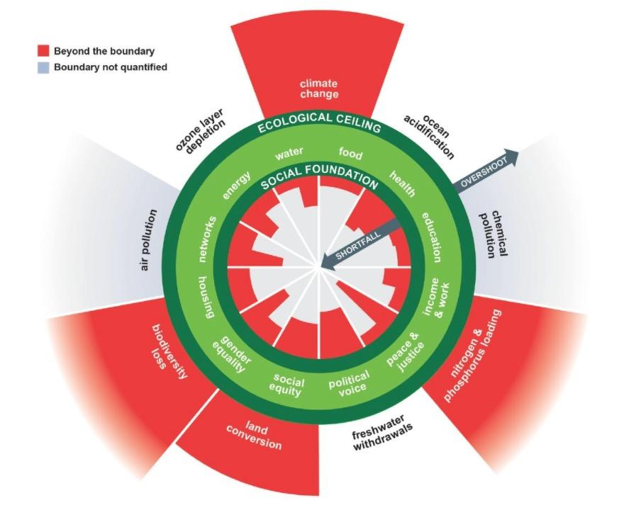
How can humanity get into the Doughnut?
Growth won’t simply
‘even things up again’
Growth won’t simply
‘clean things up again’

Slide 16
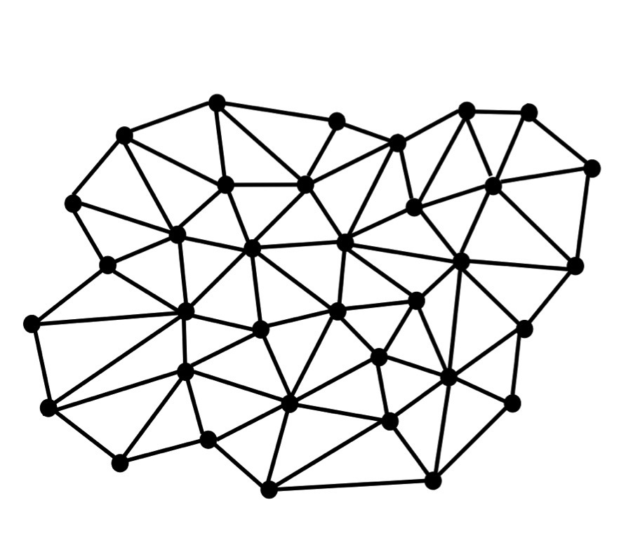
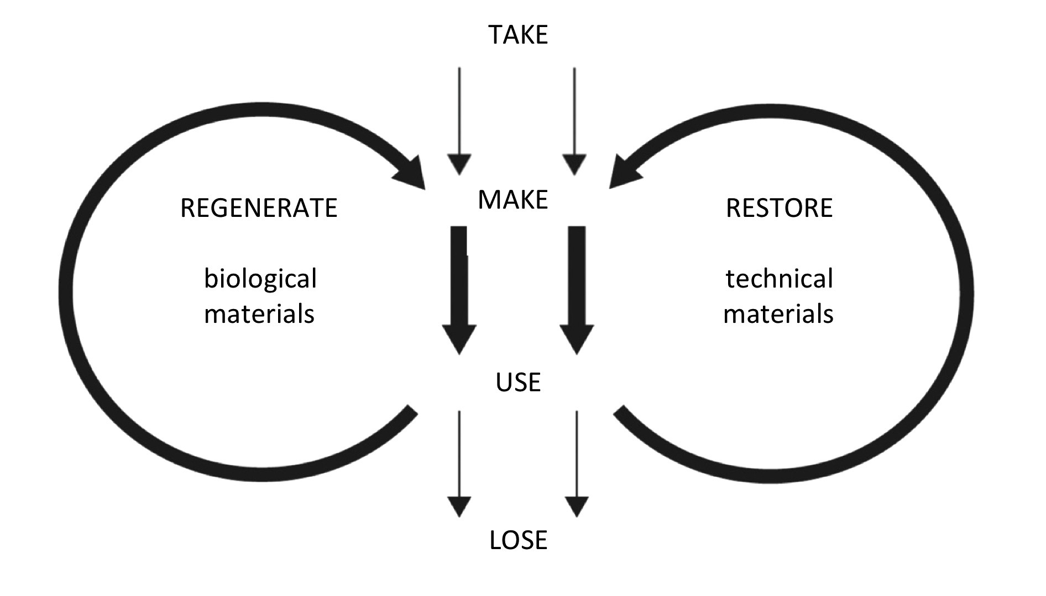
How can humanity get into the Doughnut?
Be regenerative
by design
Be distributive
by design

Slide 17
To change the future, change the dynamics
take
take
make
make
regenerate
biological
materials
restore
technical
materials
use
use
lose
lose
Degenerative
Running down Earth’s life-supporting system
Regenerative
Working with and within the cycles of the living world

Slide 18
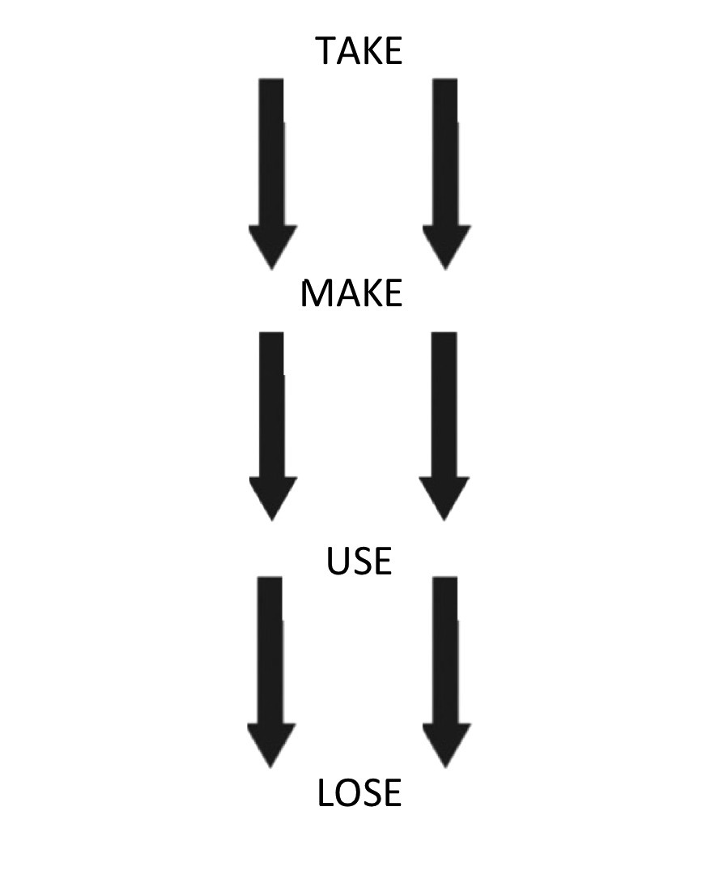
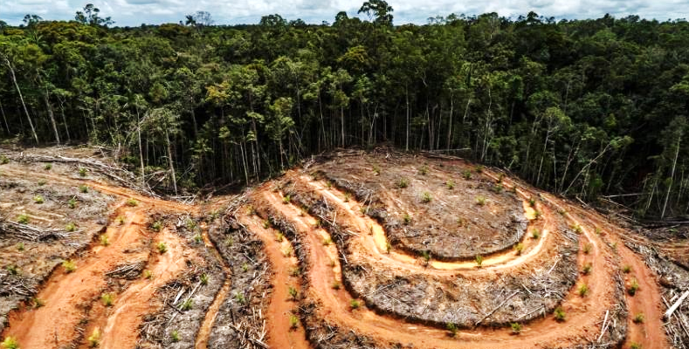
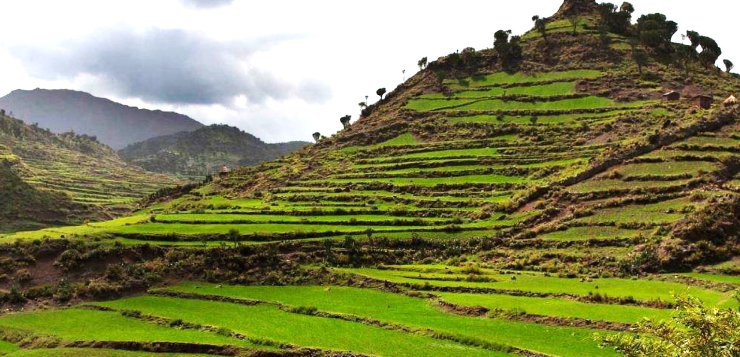
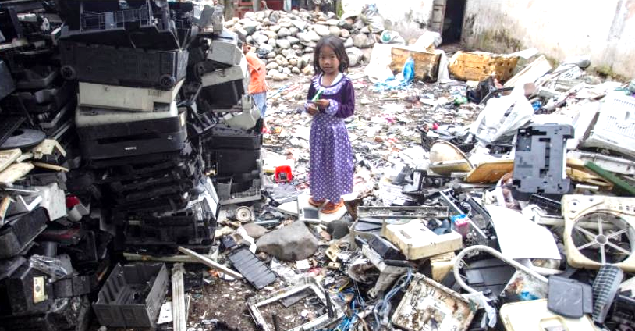
DEGENERATIVE
REGENERATIVE
Landscape degradation
AGRICULTURE
Landscape restoration
Linear manufacturing
MANUFACTURING
Circular manufacturing
Notes:
LILAC Leeds Community-led homes – mutual ownership structure https://www.communityledhomes.org.uk/success-stories/lilac
https://www.lilac.coop/
Food production in Rosario, Argentina. - IT COULD PARTIALLY WORK AS A MATCH FOR EXPLOITATIVE LABOUR ABOVE (mayor approved a municipal ordinance allowing the city to grant temporary tenure of vacant land to the urban poor for urban agriculture.) The program, designed to help improve food security and nutrition for low-income residents by strategically repurposing public land and private peri-urban spaces, now helps improve resilience to extreme events and reduce carbon emissions via more compact food supply chains.Urban farmers maintain temporary tenure of the land in exchange for its continued maintenance. https://prizeforcities.org/project/sustainable-food-production-rosario

Slide 19
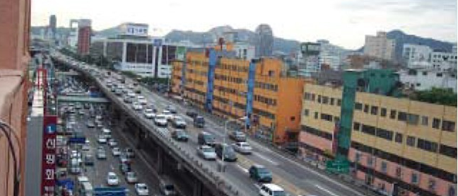
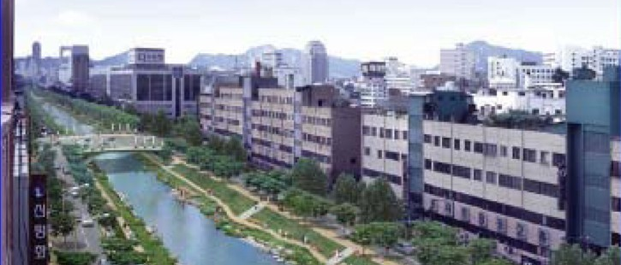
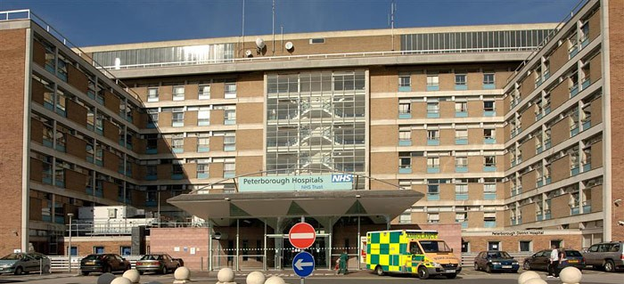
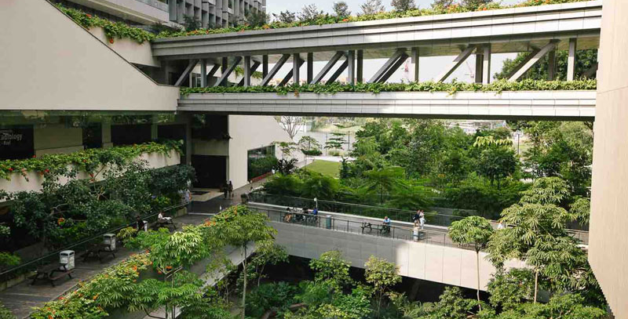
DEGENERATIVE
REGENERATIVE
Car-centred district, Cheonggyencheon, 2000
CITIES
Nature-centred district, Cheonggyncheon, 2010
Nature-less hospital, UK
BUILDINGS
Nature-rich hospital, Singapore
Notes:
Singapore hospital - designed with nature throughout, hallways in open air, community spaces that bring together not just patients but peoplel from community, rooftop where food for the hospital is grown. it can go both as regenerative and distributive - it is an example of elements in a ‘thriving neighbourhood’ as they were talking. It’s an example of a social infrastructure that also addresses the spiritual and community needs.
https://earthbound.report/2020/01/31/building-of-the-week-khoo-teck-puat-hospital/
Cheonggyencheong Stream Restoration project, Seoul.

Slide 20
To change the future, change the dynamics
Divisive
Capturing opportunity and value in the hands of a few
Distributive
Sharing opportunity and value with all who co-create it

Slide 21
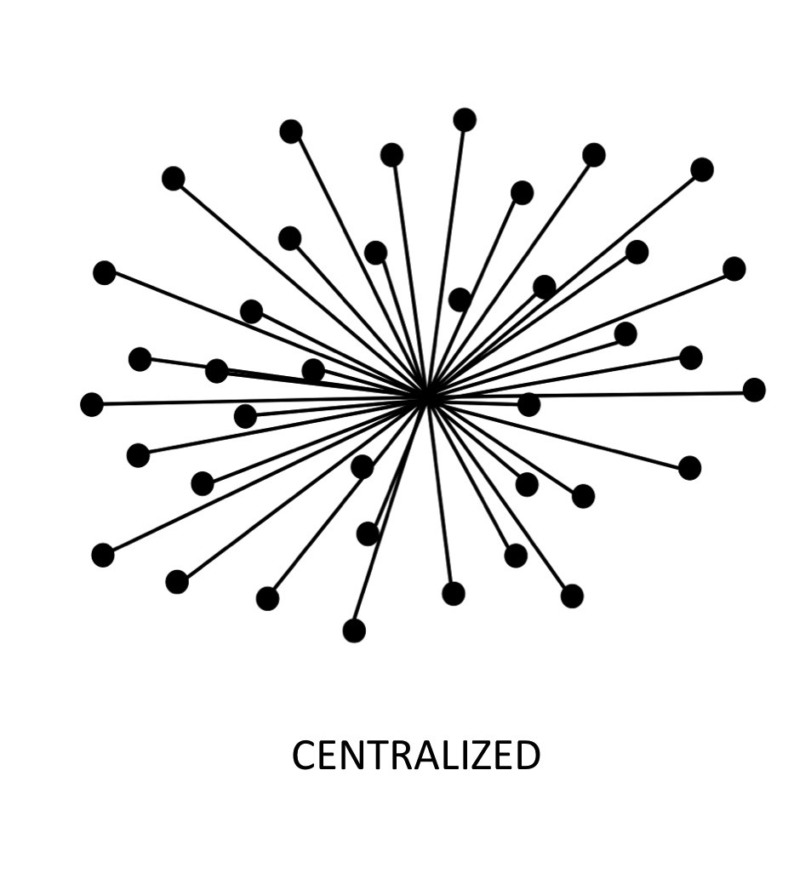
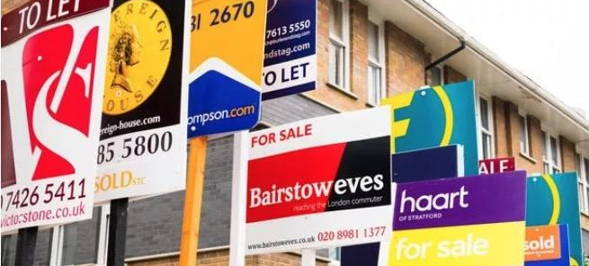
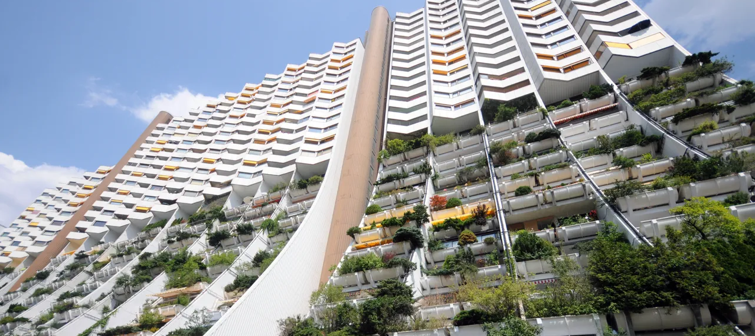
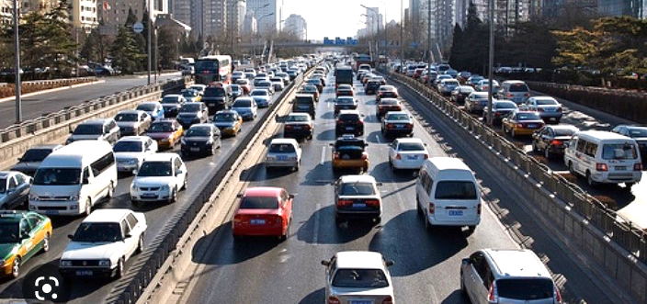
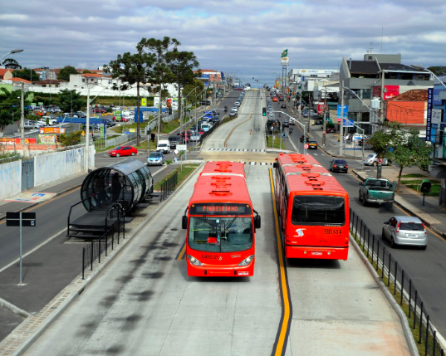
DIVISIVE
DISTRIBUTIVE
Housing and rent crisis - London
HOUSING
Affordable social housing - Vienna
Private car traffic - Beijing
TRANSPORT
Public transit - Curitiba
Notes:
London housing crisis
https://beta.londoncouncils.gov.uk/index.php/news/2021/london-epicentre-housing-crisis#:~:text=Commenting%20on%20new%20research%20from,chronic%20shortage%20of%20social%20housing.
Baan Man Kong, Thailand
https://news.trust.org/item/20210715224755-kmi5r/
https://arsomsilparchitect.co.th/en/project/sang-ton-eng-community/

Slide 22
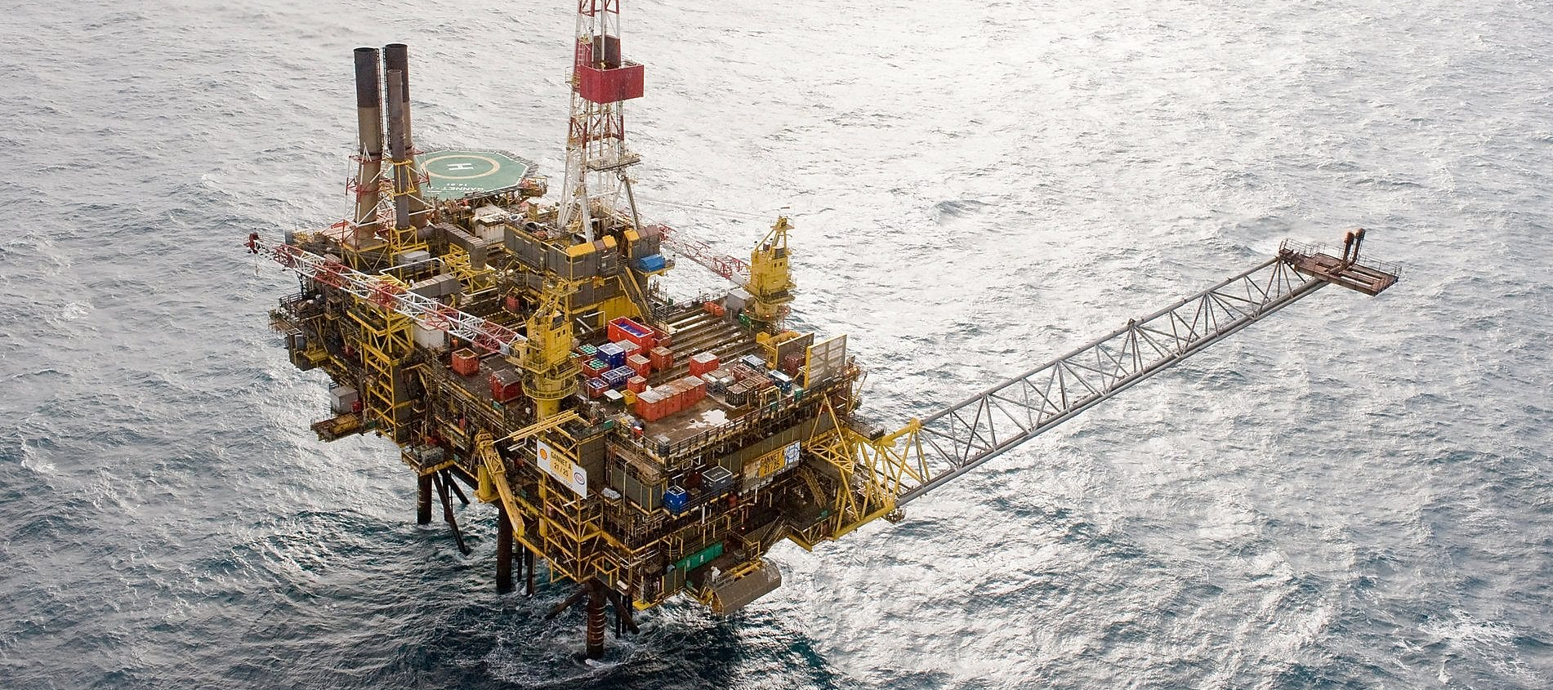
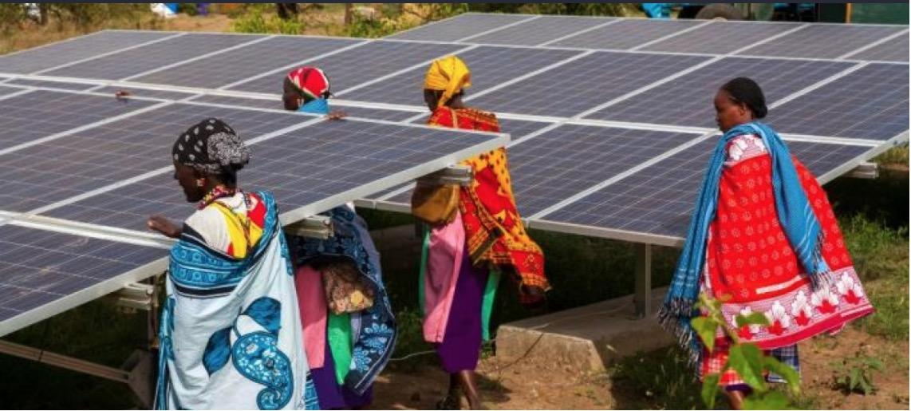
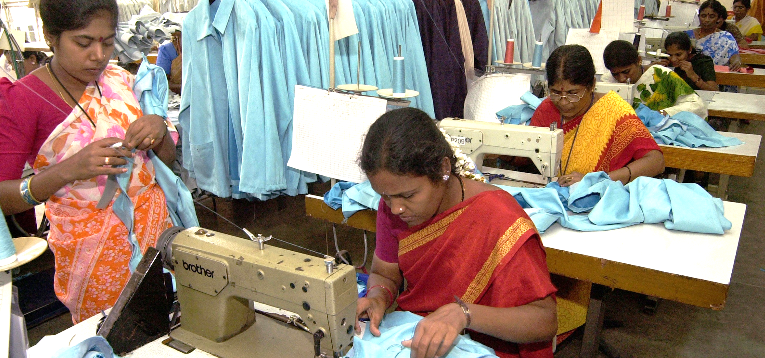
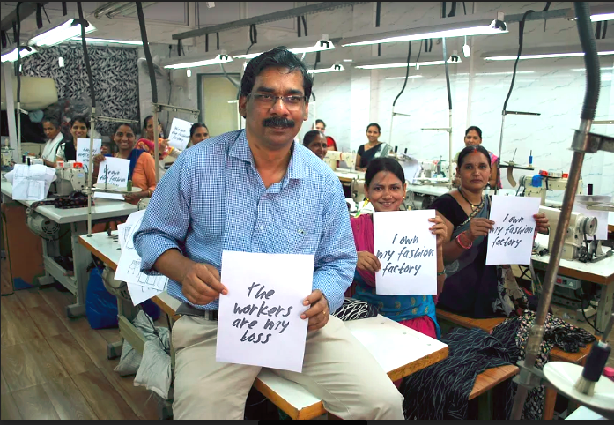
DIVISIVE
DISTRIBUTIVE
Corporate oil drilling – North Sea
ENERGY
Community micro-grids - Kenya
Profit-driven business
BUSINESS
Purpose-led business - Mumbai
Notes:
London housing crisis
https://beta.londoncouncils.gov.uk/index.php/news/2021/london-epicentre-housing-crisis#:~:text=Commenting%20on%20new%20research%20from,chronic%20shortage%20of%20social%20housing.
Baan Man Kong, Thailand
https://news.trust.org/item/20210715224755-kmi5r/
https://arsomsilparchitect.co.th/en/project/sang-ton-eng-community/

Slide 23
How can humanity get into the Doughnut?
Be regenerative
by design
Be distributive
by design

Slide 24
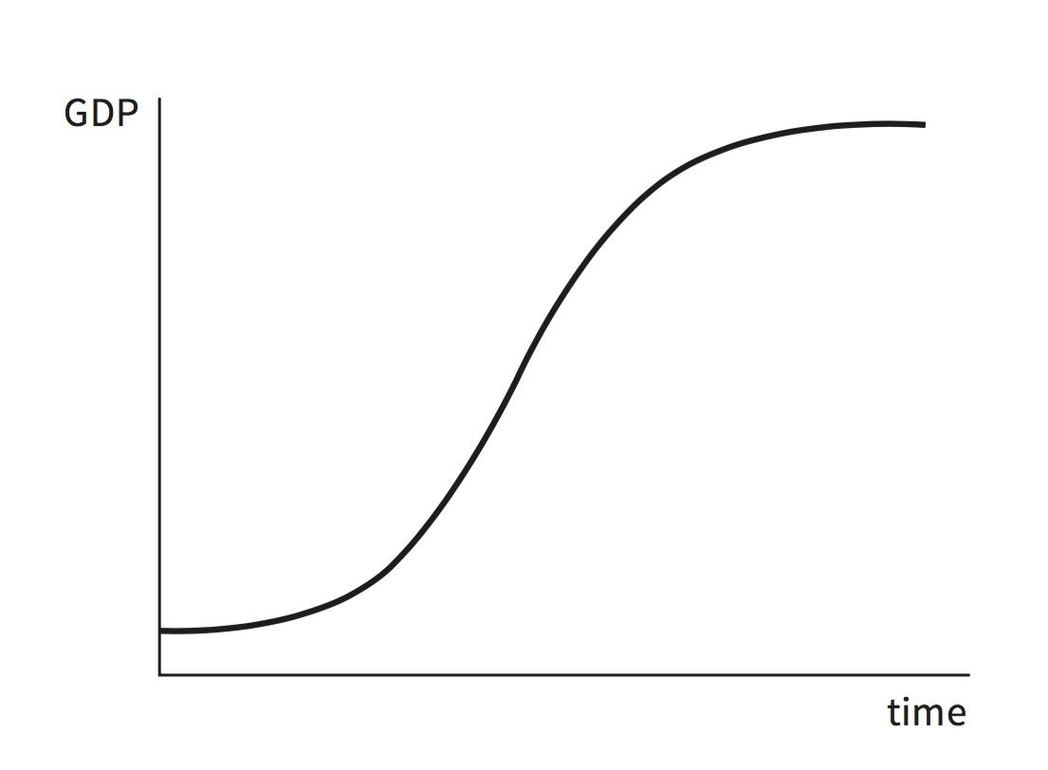
Rethinking economic growth
From endless growth
To thriving in balance

Slide 25
20th century economics
‹#›

Slide 26
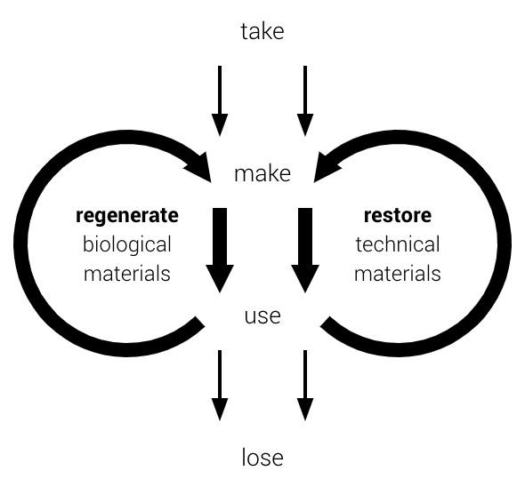
21st century economics

Slide 27
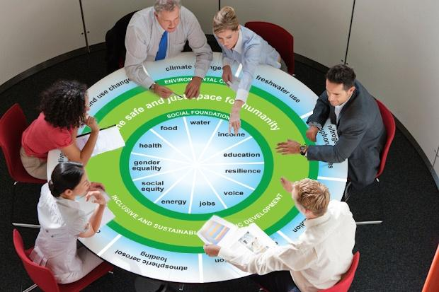
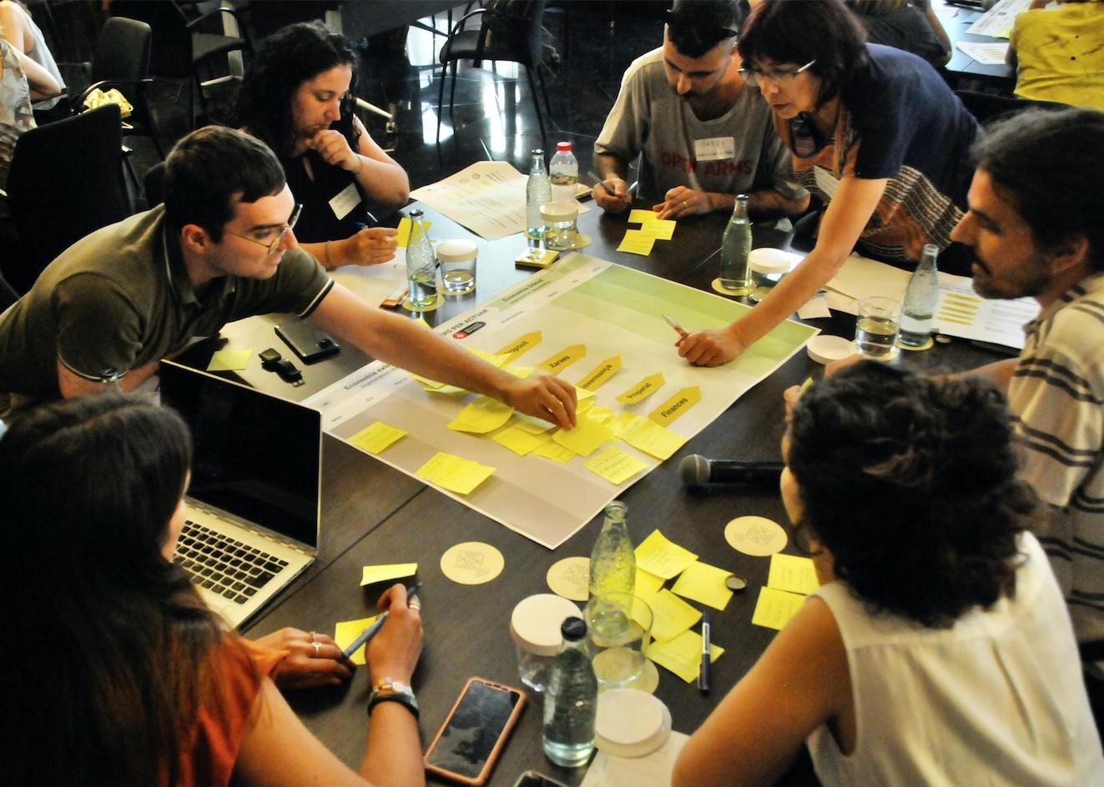
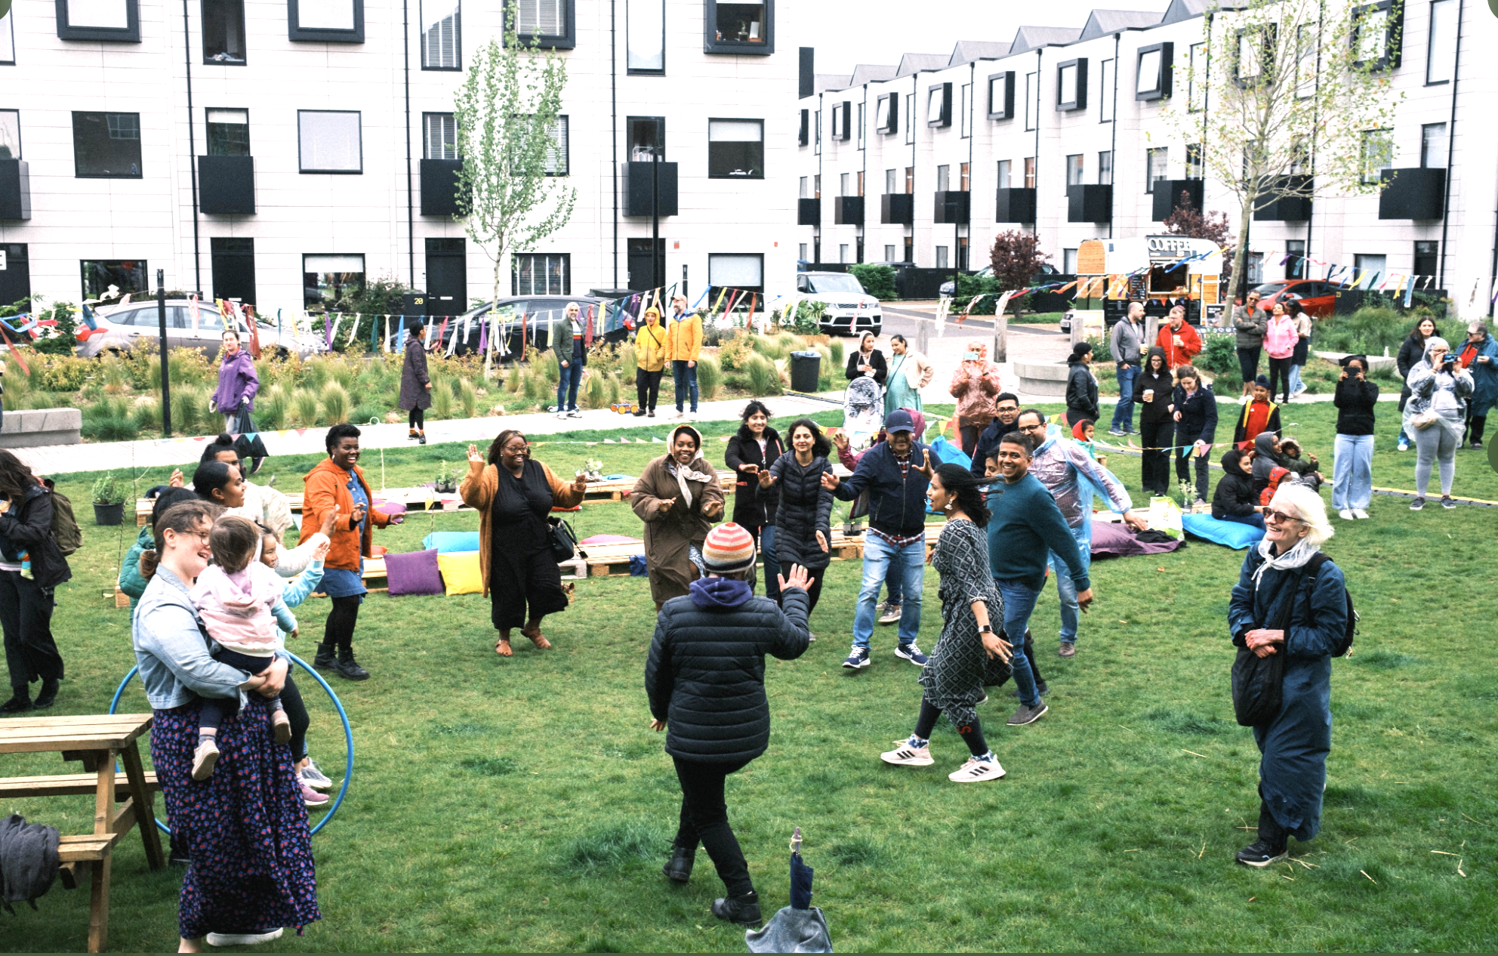
in business
in local government
in communities
in our own lives

