Slide 1
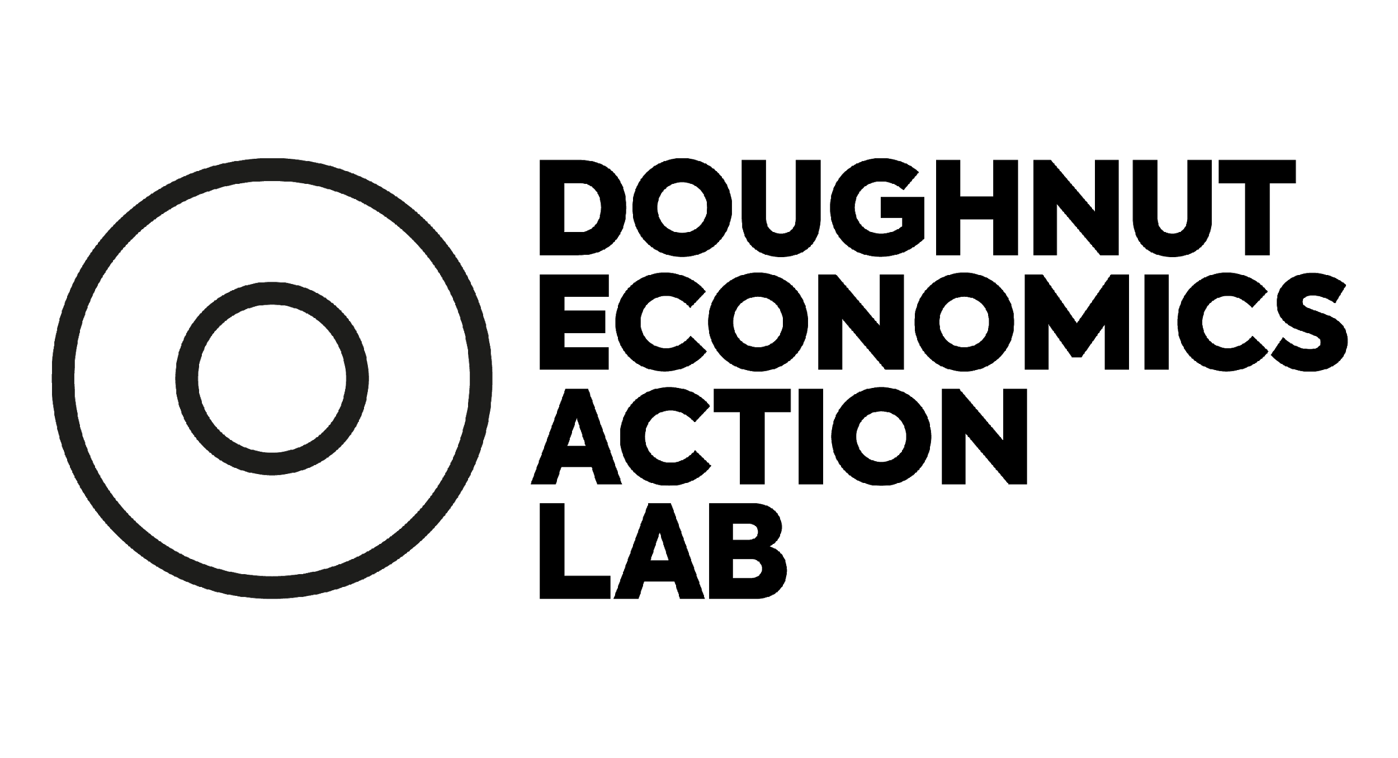
Doughnut Economics
turning ideas into action
Charting progress across countries
Andrew Fanning
September 2023

Slide 2
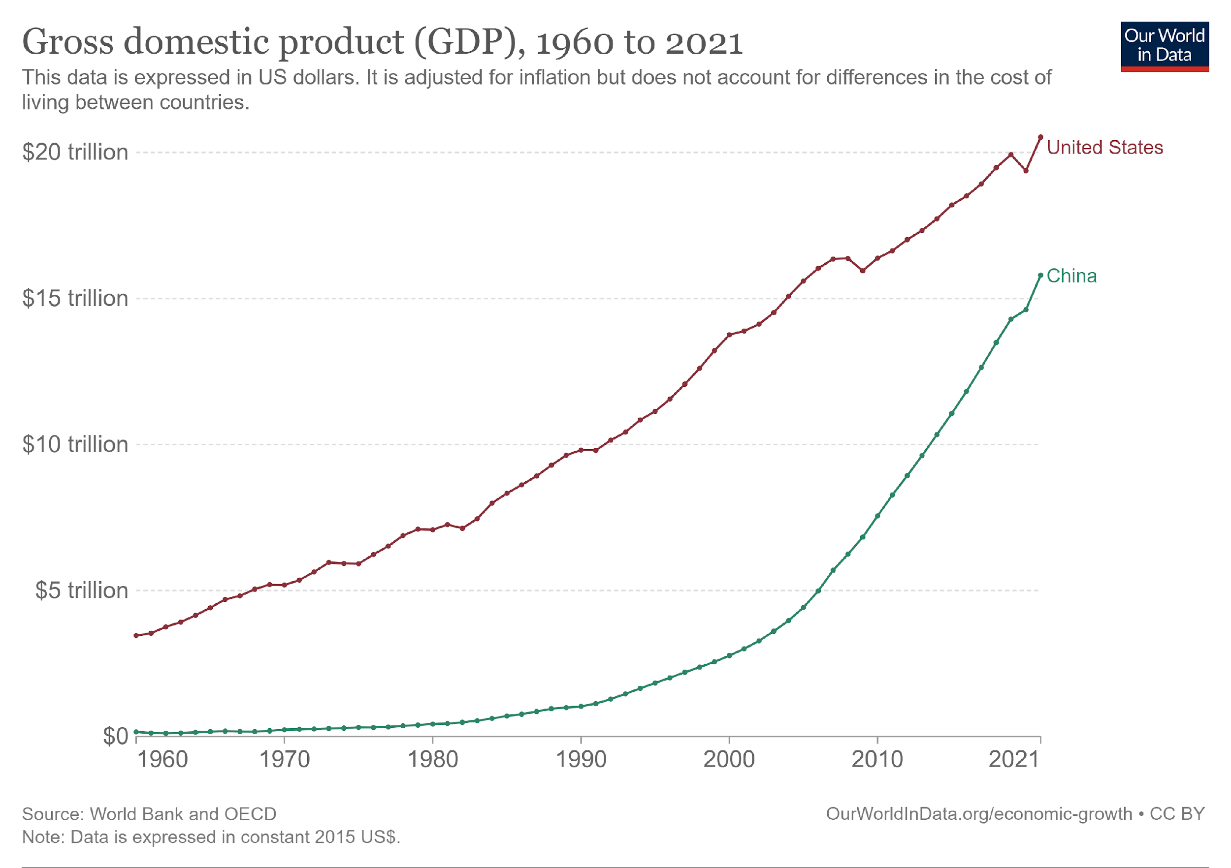
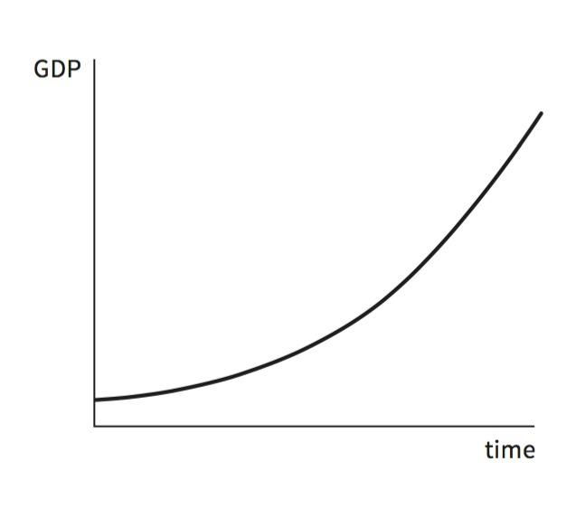
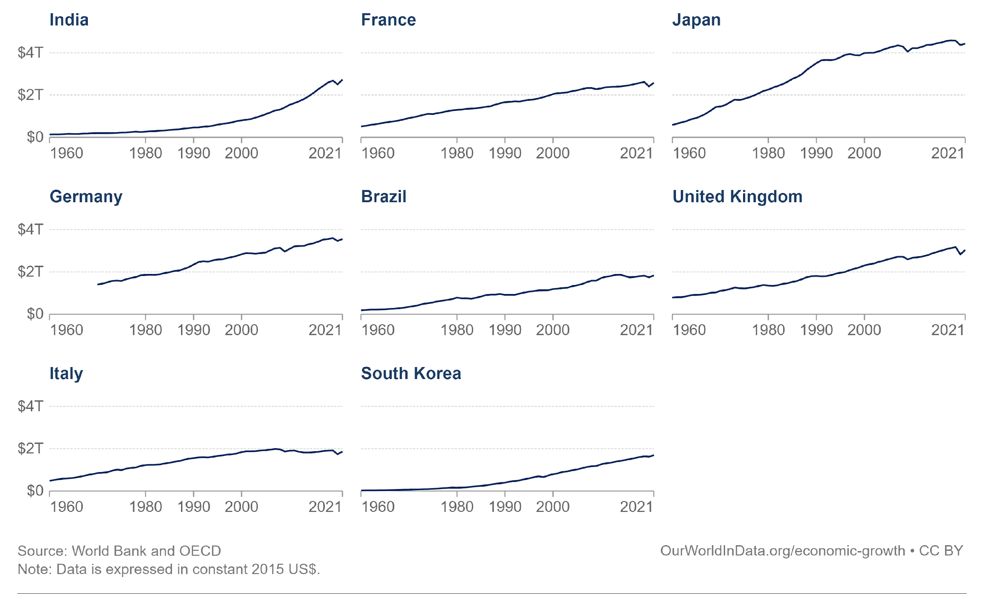
Data underpinned 20th century ‘progress’
The goal
‹#›

Slide 3
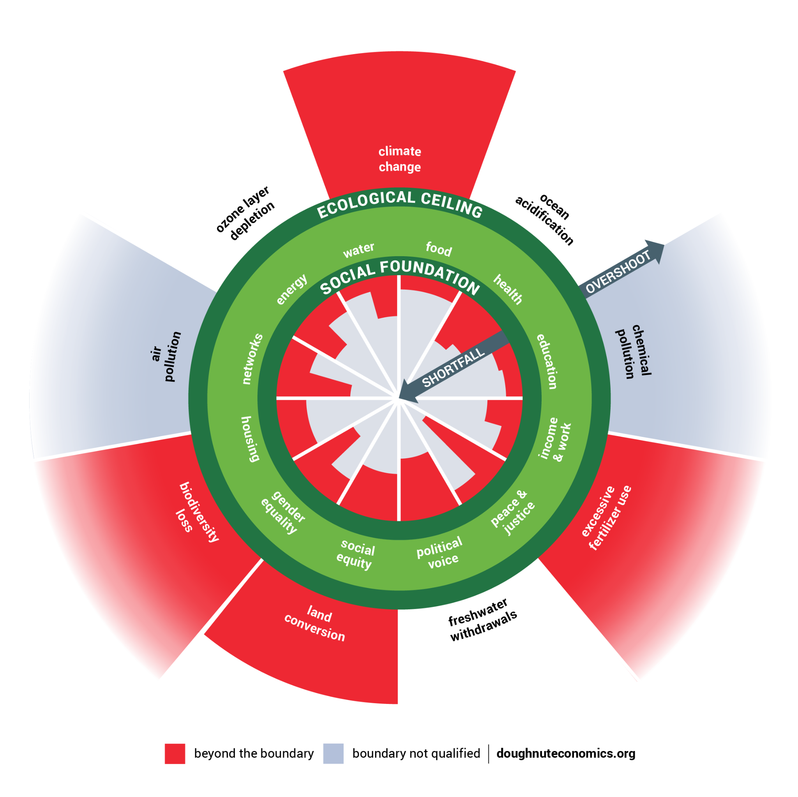
A world dangerously out of balance
Beyond the boundary
Boundary not quantified
Raworth (2017), Steffen et al. (2015)
‹#›
Notes:
Compass and map.
Also simple – focuses not on monetary flows but on nature’s flows, and on fundamental relationships of humanity to the rest of the living world.
Map just as important as doughnut – spend this session getting to know its parts, invite you to add and evolve this diagram…

Slide 4
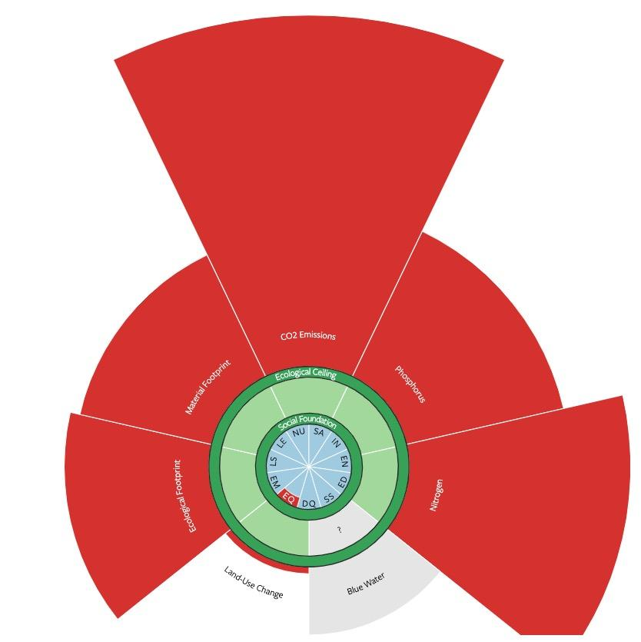
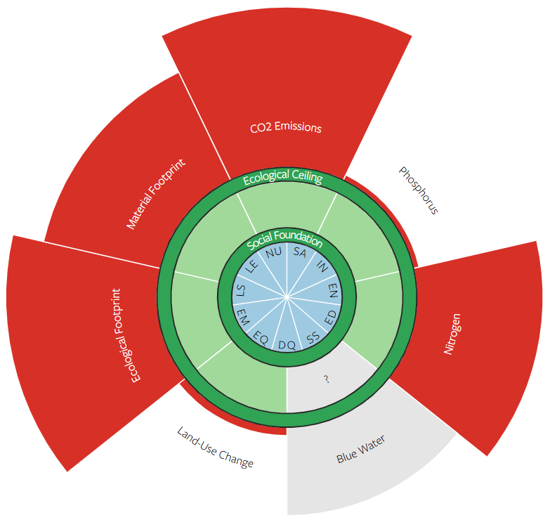
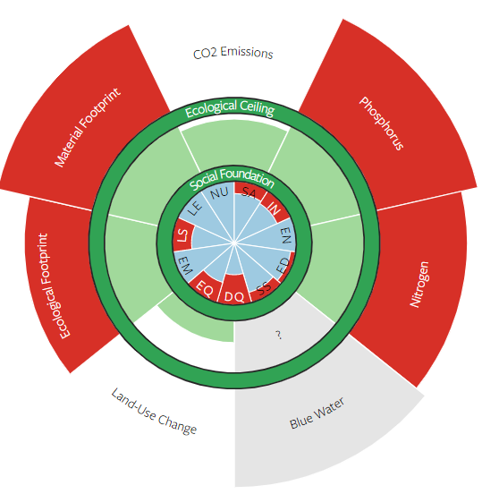
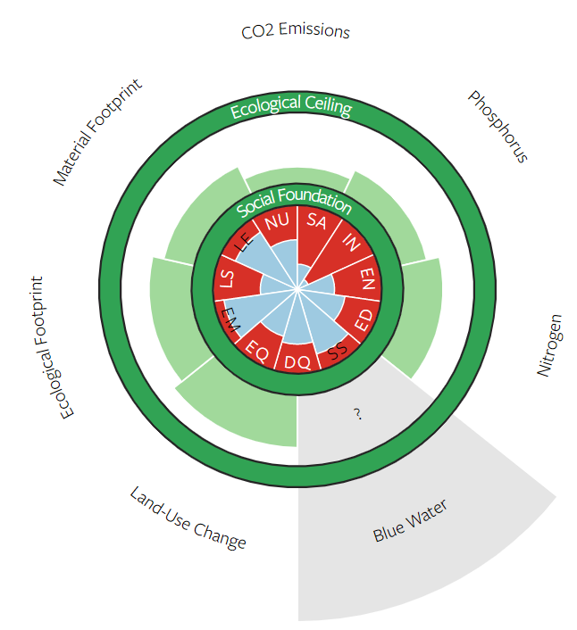
Every nation must transform
Kenya
$5,000 pc
China
$19,200 pc
Denmark
$66,700 pc
United States
$70,500 pc
GNI
https://goodlife.leeds.ac.uk
Fanning et al. (2022)

Slide 5
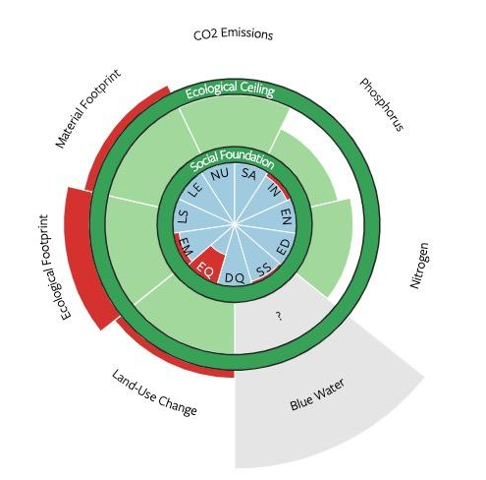
Every nation must transform
Kenya
$5,000 pc
Costa Rica
$21,800 pc
Denmark
$66,700 pc
United States
$70,500 pc
GNI
https://goodlife.leeds.ac.uk
Fanning et al. (2022)

Slide 6
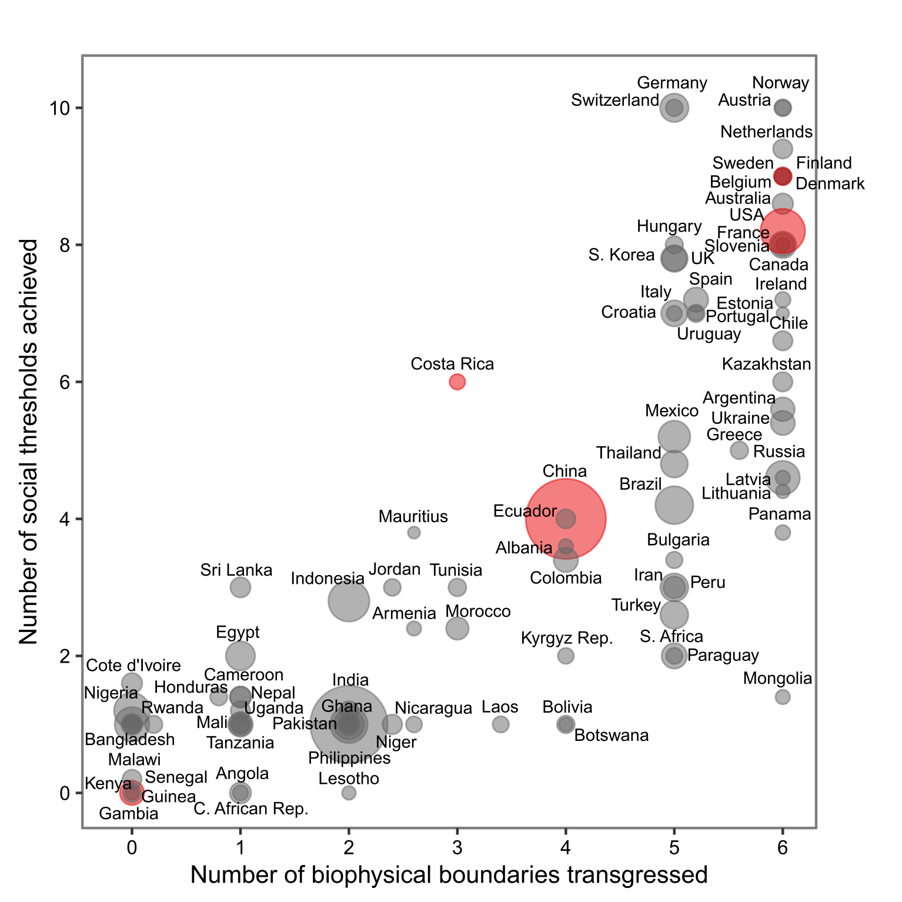
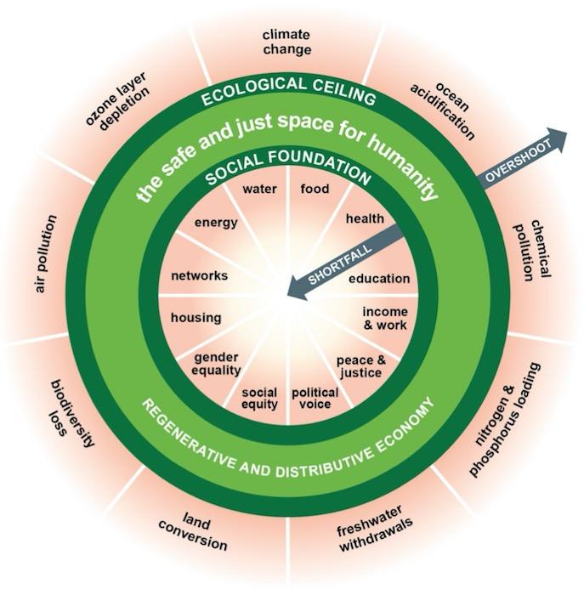
No nation is living in the Doughnut
goodlife.leeds.ac.uk

Slide 7
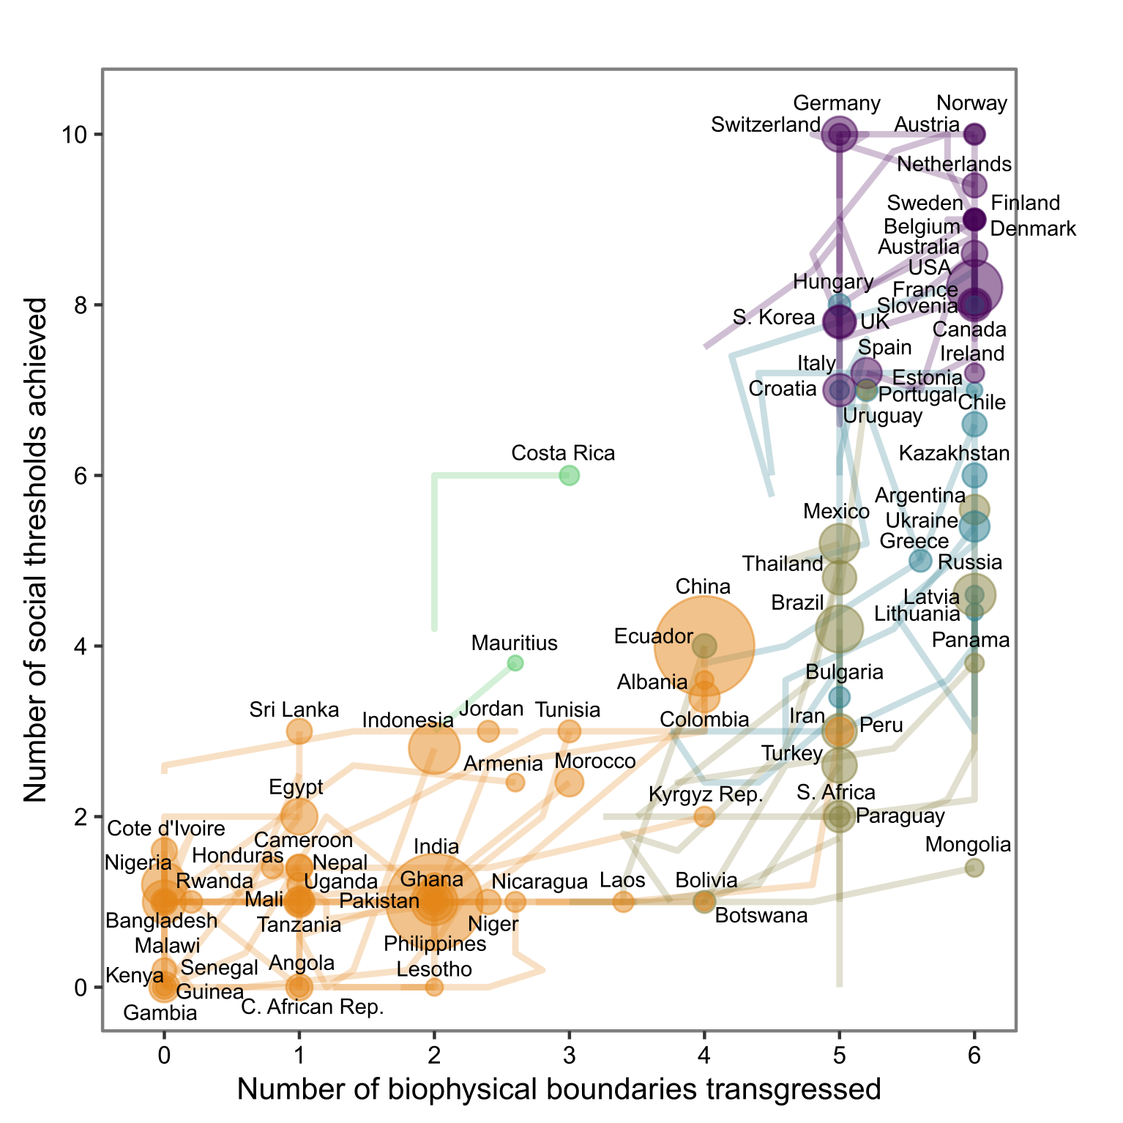
Country trajectories, 1992–2015
goodlife.leeds.ac.uk

Slide 8
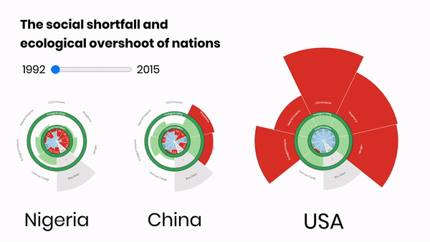
Tracking “progress” over time
Nigeria
$5,300 pc
China
$19,200 pc
USA
$70,500 pc
https://goodlife.leeds.ac.uk
‹#›

Slide 9
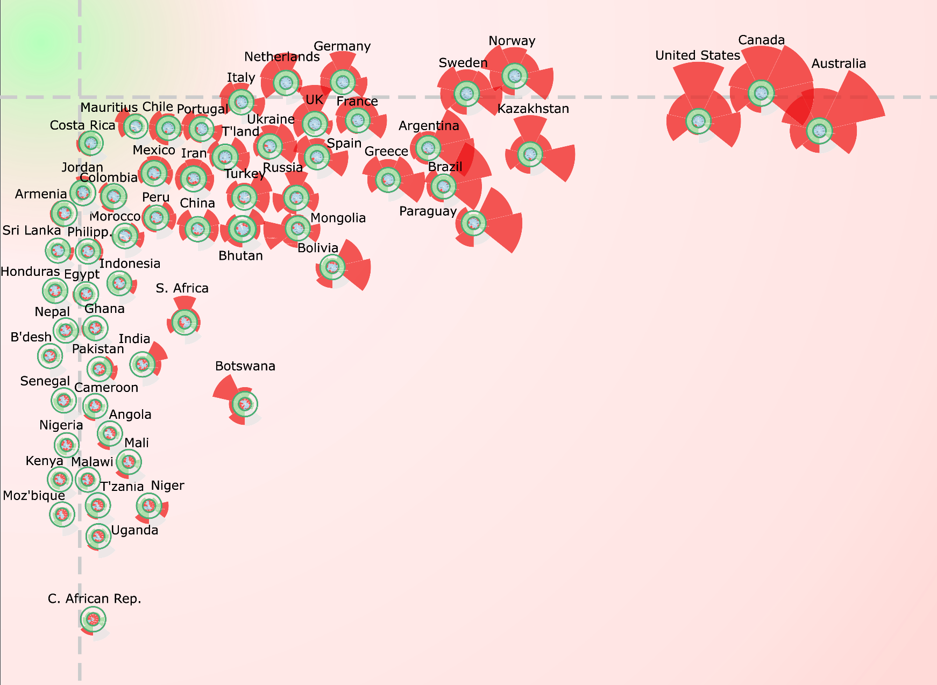
Every nation must transform
colonialism
military power
corporate power
Meeting the needs of all people
trade & finance rules
resource extraction
climate-change impacts
Within the means of the living planet
‹#›

Slide 10
The history of GDP growth
GROWTH
Meeting the needs of all people
Within the means of the living planet
‹#›

Slide 11
The future of planetary prosperity
REDUCE
REORIENT
Meeting the needs of all people
REBALANCE
RISE
Within the means of the living planet
‹#›

Slide 12
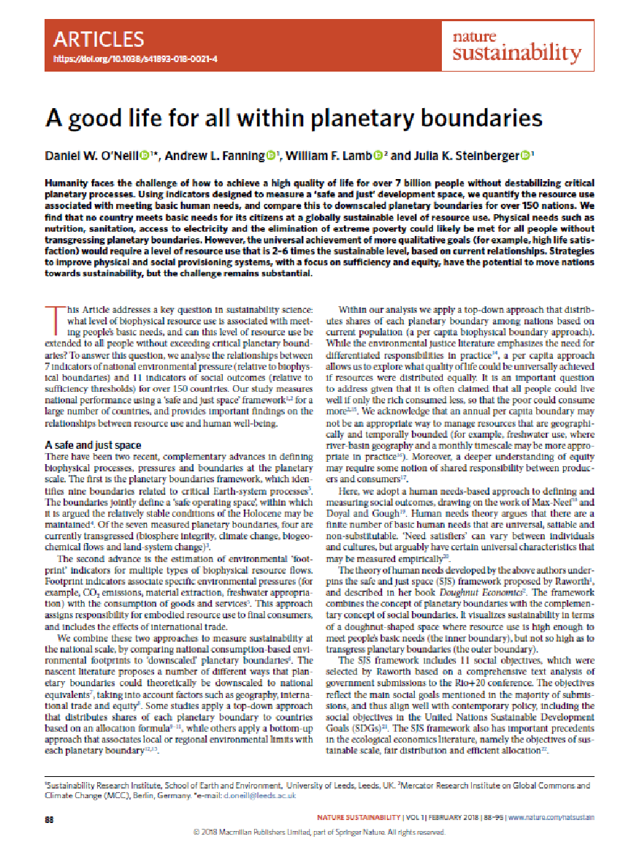
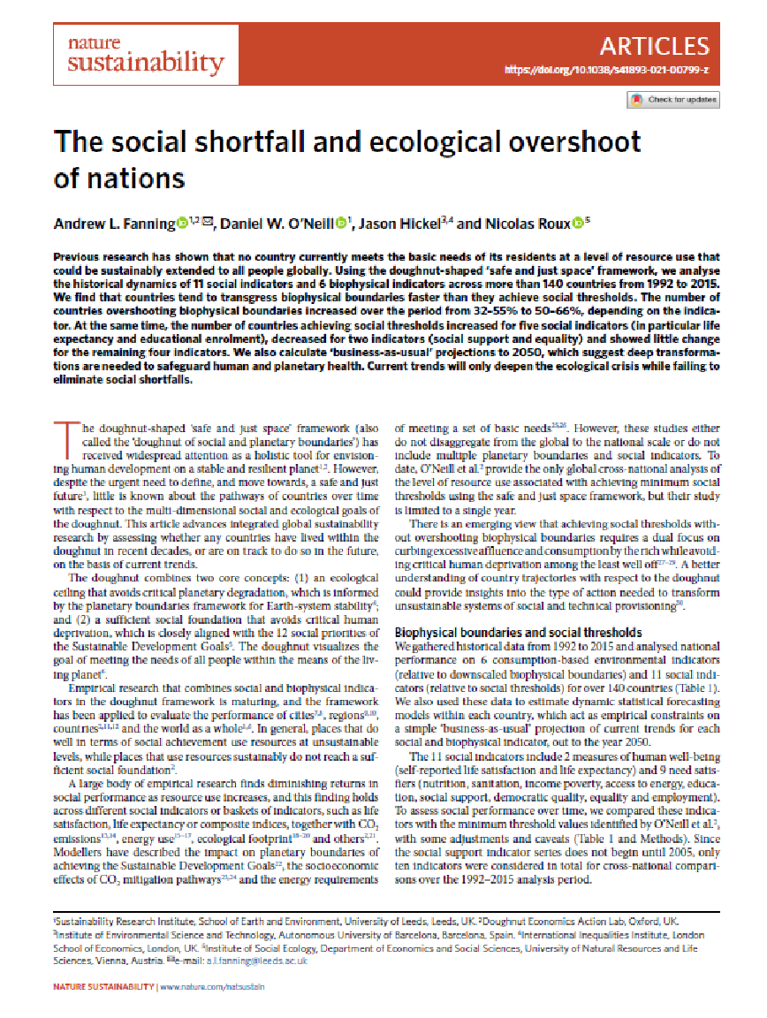
2018 study
2022 study
‹#›

Slide 13
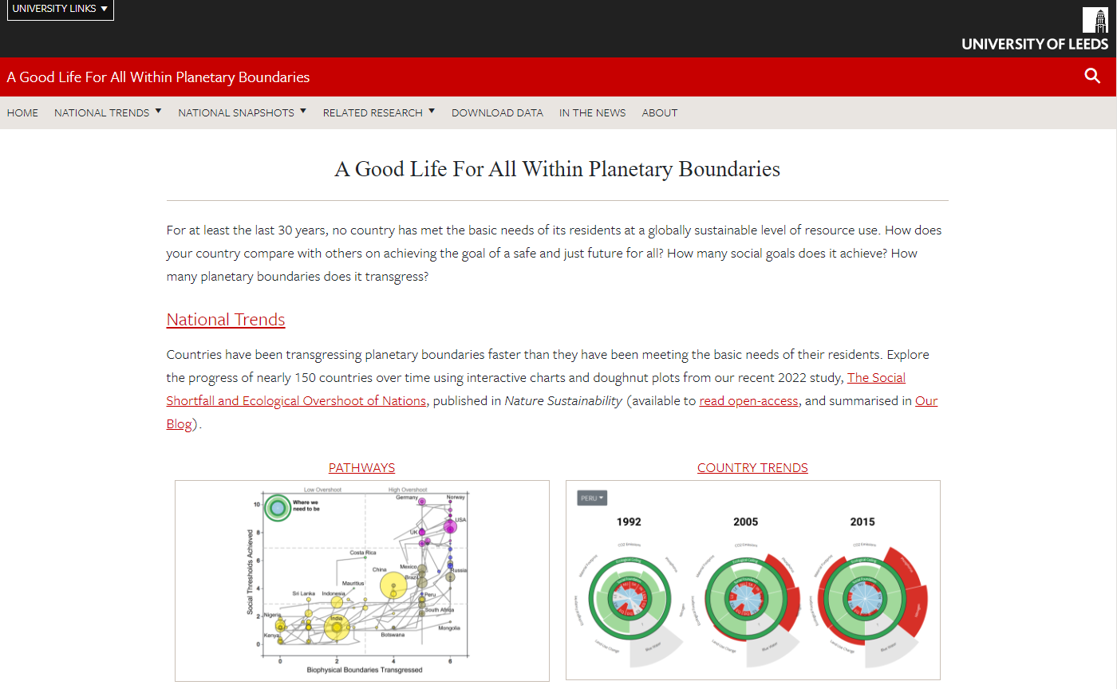
Explore interactive results online
https://goodlife.leeds.ac.uk
‹#›

Slide 15
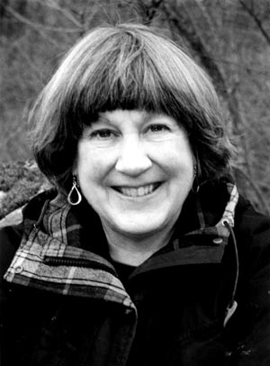
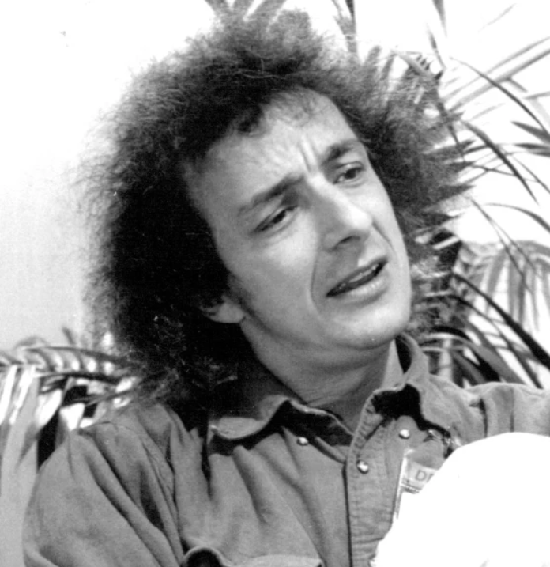
‘Data is not information, information is not knowledge, knowledge is not understanding, understanding is not wisdom.’
‘Living successfully in a world of systems requires more of us than our ability to calculate. It requires our full humanity–our rationality, our ability to sort out truth from falsehood, our intuition, our compassion, our vision, and our morality.’
Clifford Stoll
Donella Meadows

